Slide 1
The Future Role of Gas Networks in Integrated Energy Network
Devasanthini Devaraj & Dr Eoin Syron

Slide 2
Sustainable Development Goal
Affordable, reliable, sustainable & modern energy
Enhance energy research
Renewables
Cleaner fossil-fuel technology
Expand and upgrade infrastructure
Why do we care?
What can we do?

Slide 3
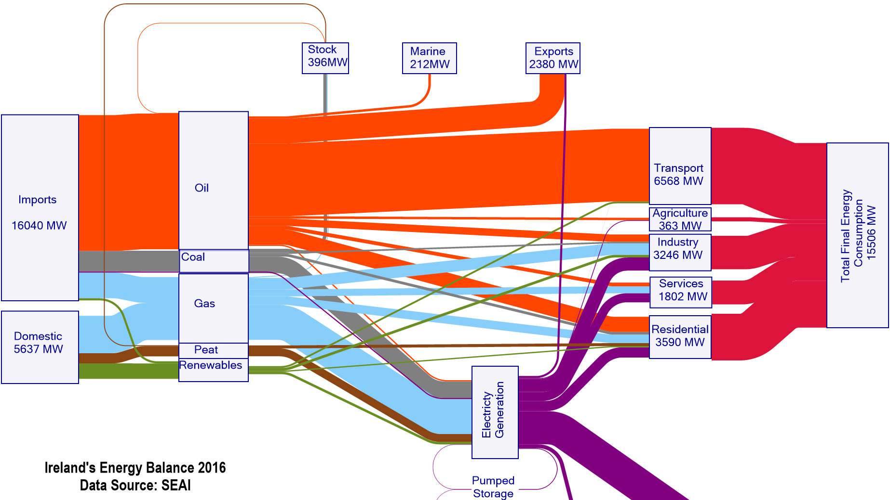
Ireland’s Energy Balance
23%
3.6%
Notes:
Where are we today?
Where we could go?
How do we get there?

Slide 4
Overview of Irish Gas Network
14,712 km of pipelines
Entry points to Irish gas system
Corrib, Inch and Moffat
30% of the total energy mix
Half of the Electricity Generation
Notes:
What is the Gas Network & what does it do today
How much energy is transported per day
Where is it coming from % break down
How much CO2 is it emitting today
Sources
https://www.seai.ie/publications/Energy-in-Ireland-2018.pdf
Notes
GNI transported 74,000 GWh of energy in 2017.
Electricity generation via natural gas was 367 gCO2/kWh in 2015, whereas it was 907 gCO2/kWh and 1059 gCO2/kWh for coal and peat respectively.
Irish gas network consists of 2427 km of high-pressure steel transmission pipelines which operates above 16 barg.
It consists of 11527 km of low-pressure polyethylene distribution pipelines which operate at 4 barg.
Content

Slide 5
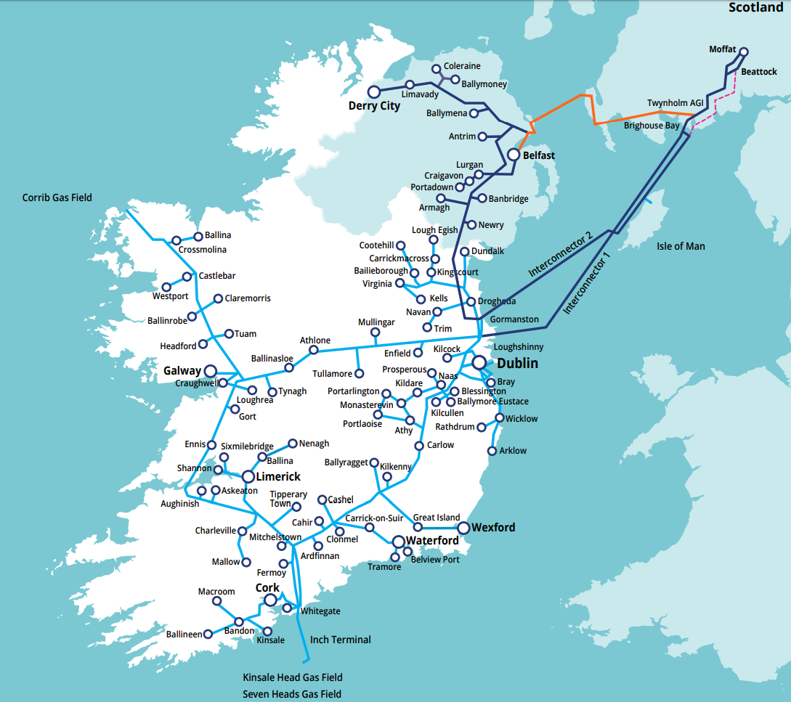
Capacity of Gas Network
Asset Value | €2.8 bn
Energy Transported | 175 GWh/day
Energy Stored
Pipe diameter | 15 inches
Length | 1 km
@70 barg | 310 MWh
@80 barg | ↑13%
@90 barg | ↑28%
Notes:
How much did it cost?
How much energy can it store/ hold?
@70Barg
@80Barg
@90Barg
Sources
https://www.ervia.ie/ervia-annual-report/GNI-Group-Financial-Statements-2017-V3.4-with-Audit-scaled-and-signatures-.pdf
Content

Slide 6
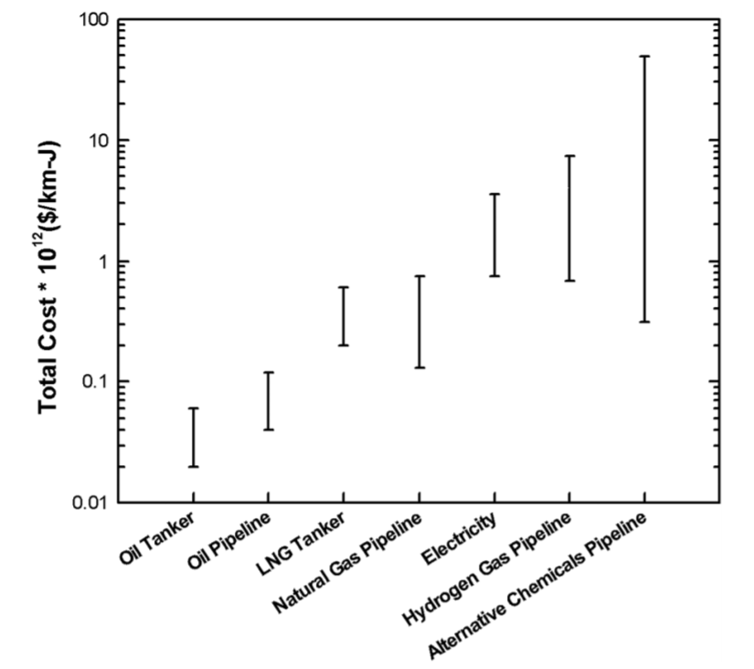
Comparison with Electric Network
Transporting gas by pipeline is cheaper
2/3rd cheaper than electricity (€ per km per kW)
Gas pipelines are less expensive to build than electric transmission lines
50 - 60% of the cost of electric lines
Notes:
Limitations of Electrical Network and storage
Comparison cost
https://pubs.rsc.org/en/content/articlelanding/2018/ee/c7ee01987d#!divAbstract
http://www.northwestchptap.org/nwchpdocs/transmission_and_n_gas_comparing_pipes_and_wires_032304.pdf
Notes
Maximum cost ($ per km per kW) to transport gas is 0.16
Minimum cost to transport electricity is 0.48
Gas costs at least 2/3rd lesser than electricity
Content

Slide 7
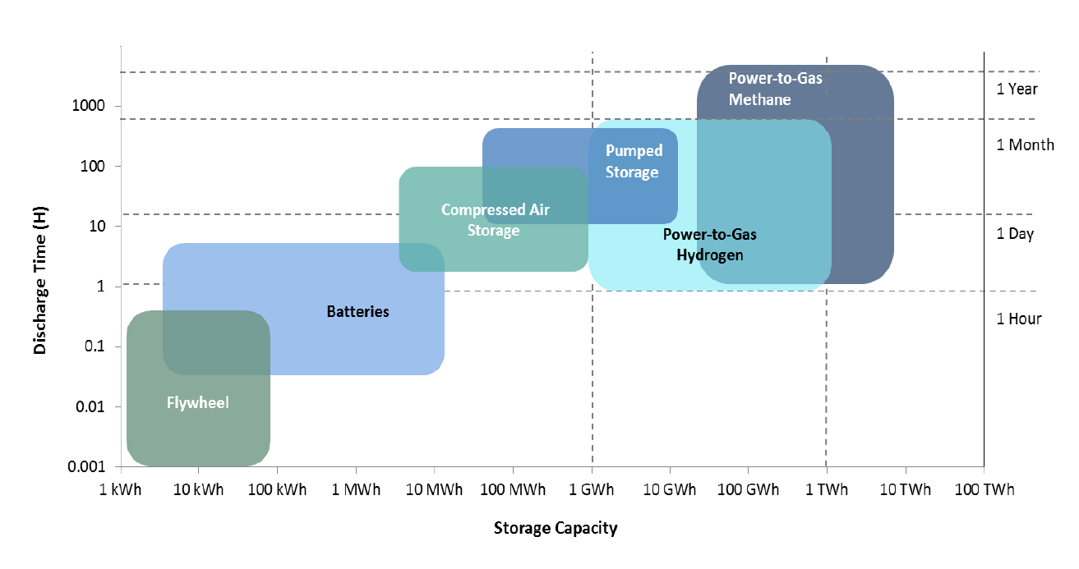
Comparison of Energy Storage Technologies
Notes:
Content

Slide 8
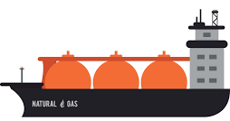
Gas Network in the Future Energy System
LNG
Line pack
Cheaper
FSRU
Substitute for pipeline imports
Gas storage in pipelines by increasing pressure
Hydrogen
Energy storage
Limitations to be used in existing network
Gas quality
CO₂
Used in SNG production
Can be transported in pipelines
Synthetic Natural Gas (SNG)
Injected into gas network
Compatible with gas appliances
BioCat
Notes:
What could it be used for in the future
Hydrogen transport
European projects
Content

Slide 9
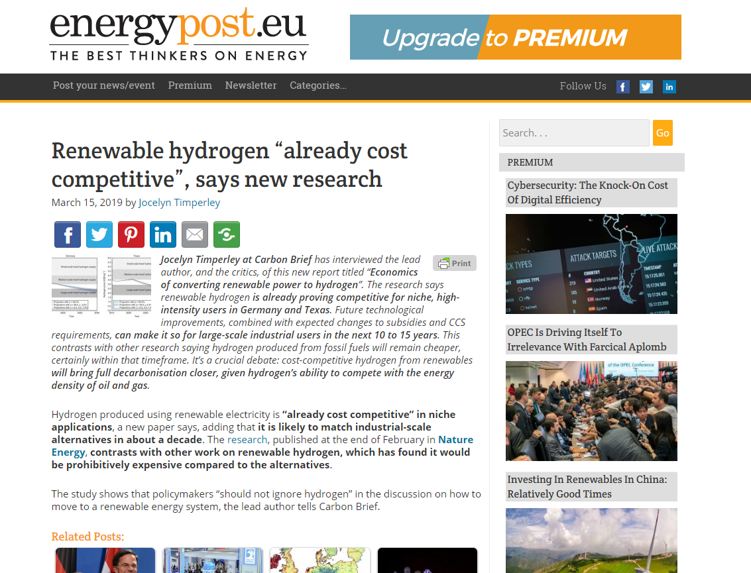
Hydrogen
sample image

Slide 10
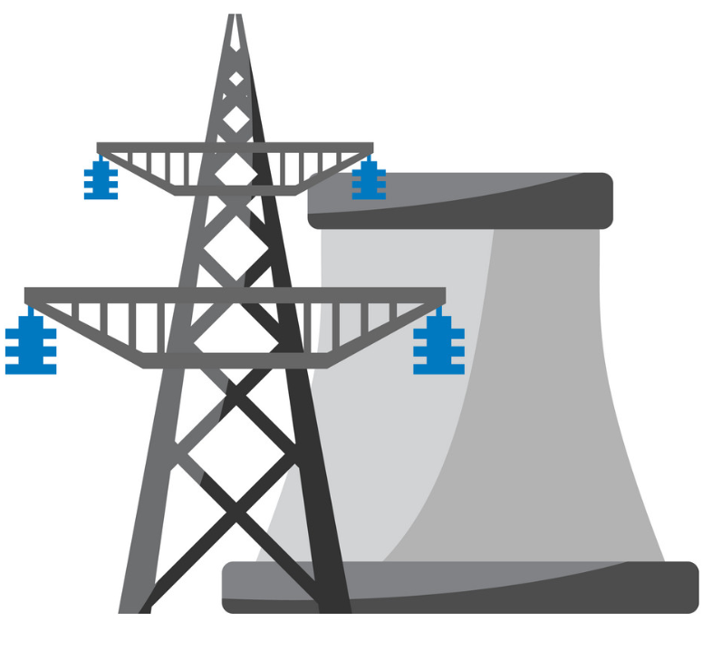
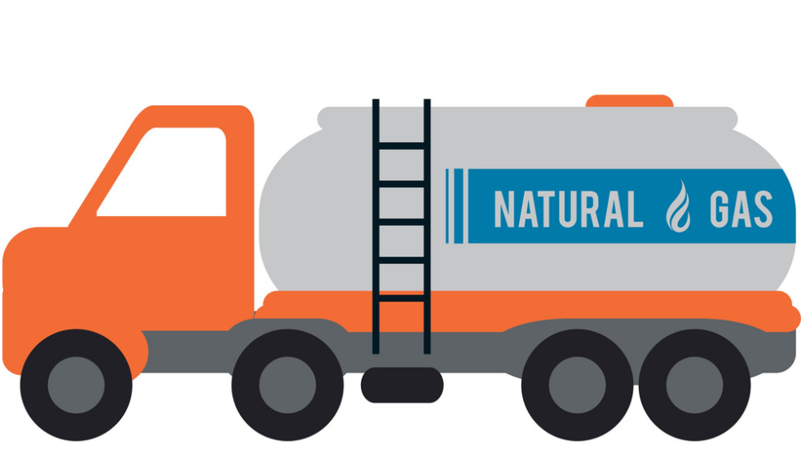
Role of Gas Network
NATURAL GAS / MIXED GAS NETWORK
Gas
CO₂
Cogeneration/CHP
Power Generation
Carbon Capture
Hydrogen
Heating
Methanation
Biomethane Injection
Electrolysis
Gas Extraction
Methane Reforming
Pipeline/LNG Imports
CNG Refuelling
Hydrogen Storage

Slide 11
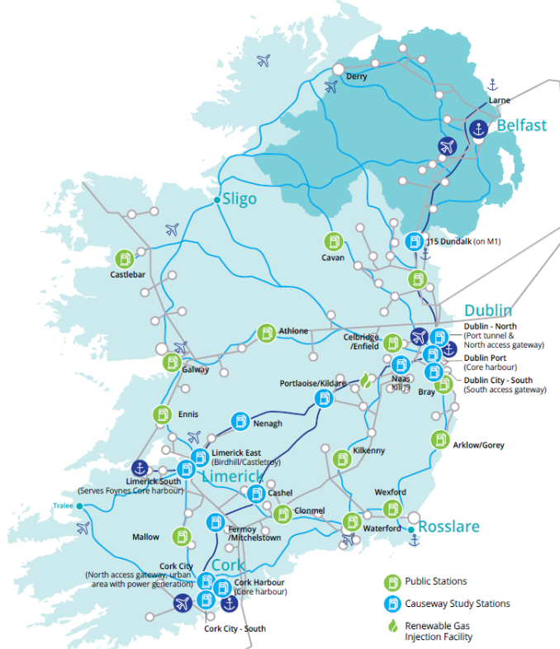
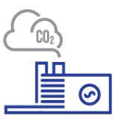
Gas Network Developments
The CAUSEWAY Project
Compressed Natural Gas (CNG) refuelling network
Renewable gas injection
CNG Vehicle fund
H21 Leeds
Convert gas network to 100% H₂ (techno-economic feasibility)
City of Cork to H₂
Carbon Capture & Storage (CCS)
Dependency on gas-fired power plants
CO₂ storage in Kinsale (local gas network for CO₂ transport)
Steam Methane Reforming + CCS
Notes:
Sources
https://www.gasnetworks.ie/business/natural-gas-in-transport/the-causeway-project/
https://www.cru.ie/wp-content/uploads/2018/12/CRU18269a-GNI-Network-Development-Plan-2018.pdf
Content:

Slide 12
Outlook for the future Gas Network:
key issues for discussion
Storage (Underground, LNG)
Transport infrastructure
Support for renewable energy sources
Immediate substantial reduction in CO₂ emissions
Hydrogen network
Recognise Decarbonisation
Less clarity or Uncertainty
Lack of consensus
Technical Issues
Existential Crisis
Route to decarbonisation
Cost and commerciality
Gas quality
Change in business
Network fragmentation?
Stake holders and Consumers
Certification
100% Electrification?
Pilot projects

Slide 13
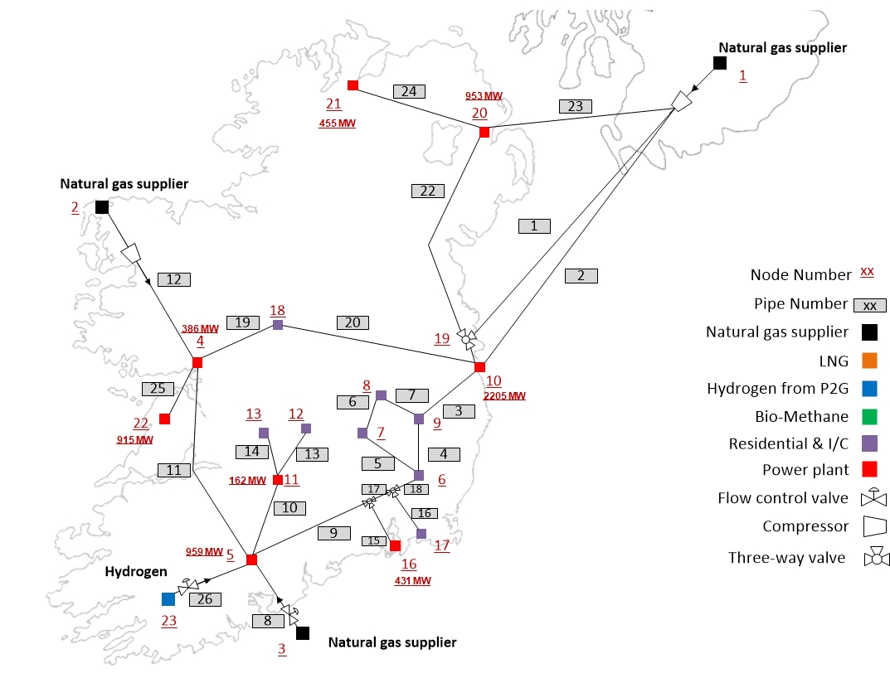
Modelling of Gas Network
P2G settings
5 MW
40 MW
120 MW
150 MW
200 MW

Slide 14
End use of gas towards a zero-emission future
Will gas be used for Renewable Energy Storage?
Will gas continued to be used in the Heating Sector?
Will gas continued to be used for Power Generation?

Slide 15
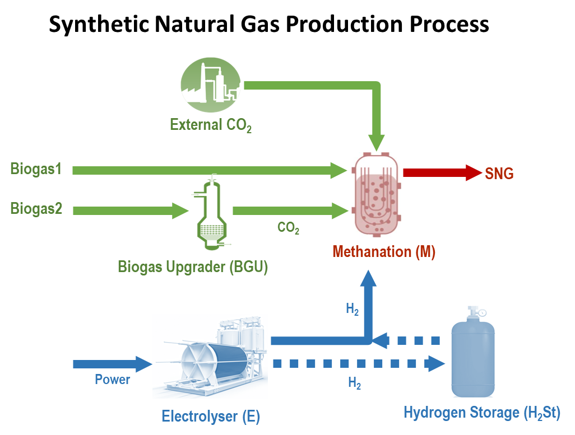
Future Role of Gas Networks
Overview
Diversification of gas sources (LNG)
De-fossilization of gas network (SNG)
Future of gas network
Incorporation of LNG via FSRU
FSRU for long-term LNG storage
Quantify Boil-off Rate and Wobbe Index
Economic Analysis
Regas unit
Storage tanks
Synthetic Natural Gas Production
Multiple process flow configurations in SNG production
Factorial design + ANOVA → maximum profit generated by SNG
Notes:
Diversification of gas sources
Increasing gas demand
Growth in LNG trade globally
Investigate the possibility of FSRU as a long-term LNG storage facility
Perform simulation to quantify boil-off rate and wobbe index of LNG during storage
Case Study: Ireland
LNG after 10 weeks of storage is suitable to inject into gas network
Price per unit of regasified LNG is 42% lower, substitute for pipeline imports
De-fossilization
Directly injected into gas network
Support the variability of renewables
Multiple process flow configurations in SNG production
Factorial design + ANOVA → maximum profit generated by SNG
Most influential variables - Methanator capacity, Electrolyser capacity & Electrolyser efficiency
Optimal configuration - Biogas upgrader as the CO₂ source and H₂ from the electrolyser
Maximum profit -10 cent/kWh of SNG
Content

Slide 16
References
1 | https://www.seai.ie/publications/Energy-in-Ireland-2018.pdf
2 | https://www.ervia.ie/ervia-annual-report/GNI-Group-Financial-Statements-2017-V3.4-with-Audit-scaled-and-signatures-.pdf
3 | A capital cost analysis of energy transmission via natural gas pipelines and overhead electric wire lines: A Joint Study by the Bonneville Power Administration and the Northwest Gas Association
4 | Saadi, Fadl H. and Lewis, Nathan S. and McFarland, Eric W. (2018), “Relative costs of transporting electrical and chemical energy”. In: Journal of Energy Environ. Sci.
5 | https://www.gasnetworks.ie/business/natural-gas-in-transport/the-causeway-project/
6 | https://www.cru.ie/wp-content/uploads/2018/12/CRU18269a-GNI-Network-Development-Plan-2018.pdf
7 | https://www.gasnetworks.ie/corporate/gas-regulation/system-operator/publications/Long-Term-Resilience-Study-2018.pdf

Slide 17
Thank you
Funded by

