Slide 1
Exploring the energy-for-water nexus:
Can wastewater treatment facilities provide demand flexibility?
DATE
17/09/2019
AUTHORS
Dana Kirchem
Muireann Lynch
(The Economic and Social Research Institute)
Eoin Casey
(University College Dublin)
Juha Kiviluoma
(VTT Technical Research Centre of Finland LTD)
Valentin Bertsch
(German Aerospace Center, University Stuttgart)

Slide 2
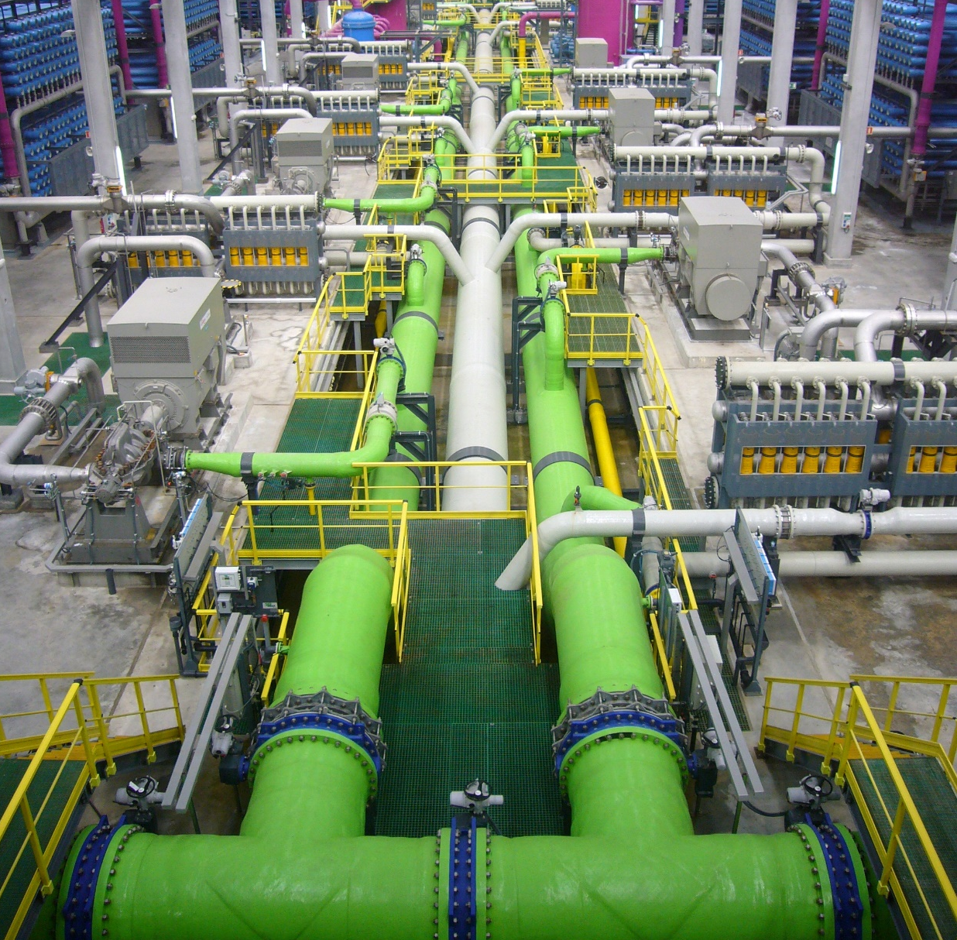
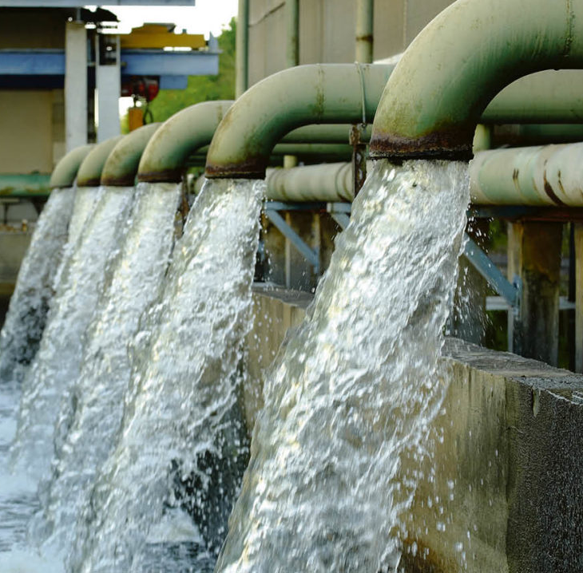
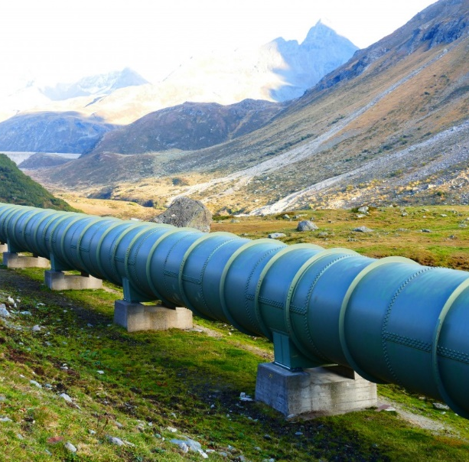
Motivation
Literature
Modelling framework
Results
Discussion
Water and energy are interconnected in many ways
Water for energy
Energy for water
Notes:
Two sides of the water-energy nexus:
Water for energy
Cooling in thermal power plants
Extraction and refining of fossil fuels
Growing crops for biofuels
Hydro power
Water ways as routes of transport for primary energy sources
Energy for water
Fresh water supply and treatment
pumping and disinfection of ground water or surface fresh water
desalination of sea water or brackish water
Pumping in water distribution
Heating or cooling in water consumption
Pumping, disinfection and aeration in conventional wastewater treatment
Wastewater treatment the most energy-intensive process in the water cycle (except desalination) and
In countries with well-developed water distribution and treatment systems, the wastewater treatment sector can be a big electricity consumer, accounting for about 3 percent of total electricity consumption of a country per year (Gude, 2015).
Literature:
Gude, V. G. (2015). Energy and water autarky of wastewater treatment and power generation systems.
Renewable and sustainable energy reviews, 45:52–68.

Slide 3
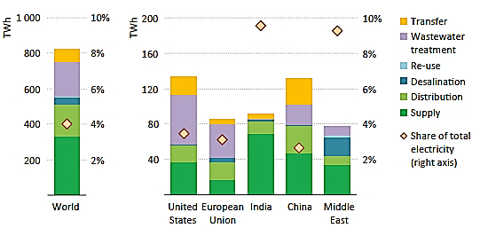
Motivation
Literature
Modelling framework
Results
Discussion
Electricity consumption in
consumption
Electricity consumption in the water sector by process and region in 2014; Source: IEA (2016).
Notes:
Global situation regarding the energy-for-water nexus:
In developed countries, 42% of water-related electricity consumption is used for wastewater treatment.
(Globally, wastewater treatment consumes about 200 TWh of energy.)
Literature: International Energy Agency (2016): World Energy Outlook 2016

Slide 4
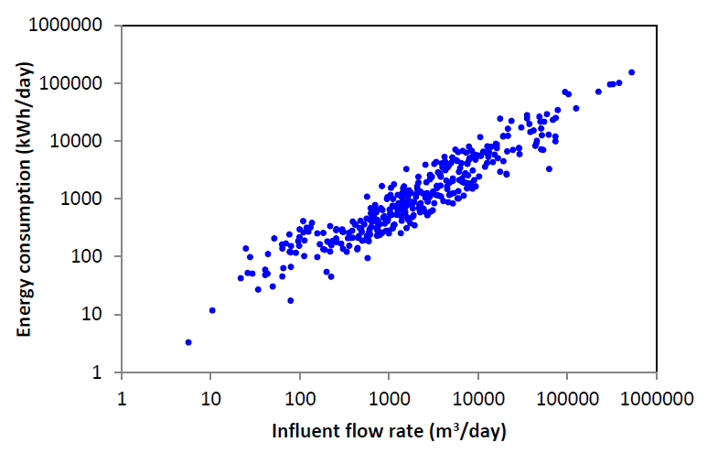
Motivation
Literature
Modelling framework
Results
Discussion
345,592
5.00
449
Wastewater treatment plants (WWTP) in Ireland with at least secondary treatment
What is the demand response potential for the power system?
What are the effects on
The energy system
The WWTP operation
The environment?
Sources: ENERWATER (2015), EPA (2012)
Notes:
Wastewater treatment is a big electricity consumer
About 40% (on average) of the electricity consumed is for secondary treatment
Aeration of the wastewater
About 20% (on average) is consumed in primary treatment
Pumping of wastewater
Case studies have shown that these processes allow for flexible operation
Ireland has 449 plants with secondary treatment
Given that the electricity consumption of the sector is significant and that a major part of the electricity consumption could potentially be shifted in time:
What is the demand response potential for the Irish power system? (-> Quantification)
Further on, if this potential can be harnessed: What are the effects on
The power/ energy system
The WWTP operation
The environment

Slide 5
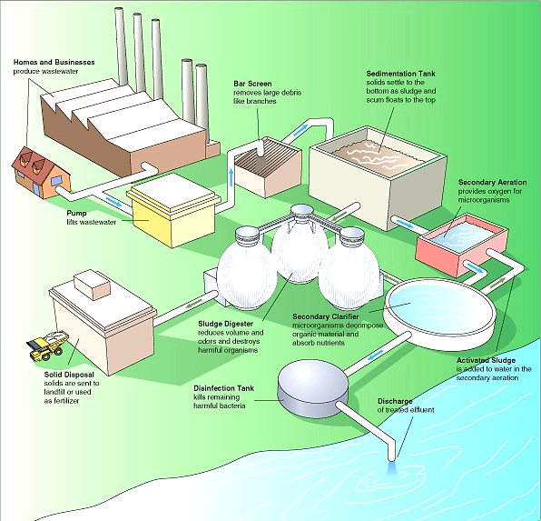
Motivation
Literature
Modelling framework
Results
Next steps
Case study results for flexibility options:
Flexible aeration | Intermittent pumping | Built-in redundancy | Biogas production
Maximum switch-off time between 15 minutes (Berger et al., 2013; Kollmann et al., 2013) and 120 minutes (Schaefer et al., 2017; Nowak et al., 2015) | Maximum switch-off time up to 30 minutes for inlet pumps (Nowak et al., 2015) and 60 minutes for recirculation pumps (Schaefer et al., 2017) | Precondition for switching-off pumping, withholding of waste water in tanks and sewers (Olsen et al., 2012) | Flexibility potential arises from biogas storage (Seier and Schebek, 2017; Schmitt et al., 2017)
Notes:
Case study results:
Aeration
Berger et al. (2013) and Kollmann et al. (2013) evaluate a possible switch-off duration of only 15 minutes.
Schäfer et al. (2017) conduct a case study on a German WWTP and find that the aeration can be switched off for 60 minutes without a significant decline in effluent quality, with a maximum effective power flexibility of 98.6 kW
Nowak et al. (2015) come to a similar result, turning off the aeration for a period of 60 to 120 minutes without breaching the effluent standards.
Intermittent pumping
Inlet pumps show lesser degree of flexibility (can be switched off for up to 30 minutes), while internal pumping (recirculation) can be shut down for longer
Shutting down pumps requires a certain amount of available redundancy within the WWTP or the sewer system in order to withhold wastewater until it is pumped on
Built-in Redundancy
The study by Olsen et al. (2012) finds potential for flexibility in pumping due to overcapacity in the San Francisco sewer system and the WWTP.
Findings suggest that lift pump could be curtailed for several days.
However, the authors emphasise that the redundancy serves the purpose to account for the risk of heavy rain fall events. Therefore, redundancy can only be considered for demand response in dry-weather periods, when the risk for heavy rain fall is low.
Biogas
Seier and Schebek (2017): Their findings suggest that German WWTPs, which are using biogas for electricity generation, have a potential to integrate 120 MW of surplus electricity
The load shifting potential arises solely from a biogas storage option, which can be used to generate electricity on-site in a CHP plant
Schmitt et al. (2017) calculate a total flexibility potential for WWTPs in Germany of 2,057 MWh/day of additionally available load and 2,391 MWh/day of curtailable load for the whole treatment process.
Literature
Müller, E., Graf, E., Kobel, B., Hurni, A., Wenger, R., Frei, U., Christen, C., Moser, R., Fritzsche, C., Mathys, O., Kernen, M. & Fahrni, J.: Potential der Schweizer Infrastrukturanlagen zur Lastverschiebung (Potential of
Swiss Infrastructure Plants for Load Shifting). Final Report. June Bern, Switzerland 2013.

Slide 6
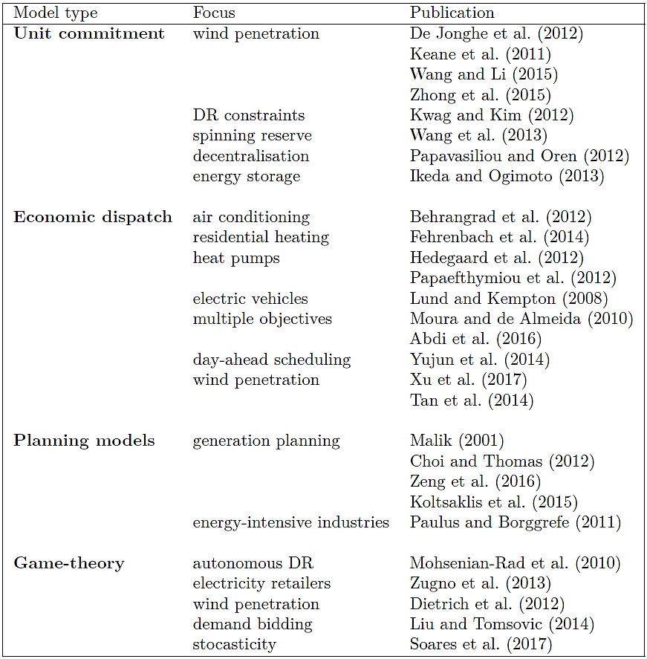
Motivation
Literature
Modelling framework
Results
Discussion
Energy system models with a focus on end-user demand response
Notes:
ED models aim to minimise the operating cost of the whole energy system by determining the optimal power output of each generator [50]. The optimisation is subject to system constraints such as the system demand, technological constraints of generating units, availability of resources and fuels or political constraints.
UC models also determine the optimal output of each generator at each time step, but additionally consider that generators can be turned on or off dynamically. That means that not necessarily all available generators in the system provide energy all the time. The decision whether to engage a generator in the energy supply depends on the trade-off between the costs for that generator of providing energy and the costs of switching it off.

Slide 7
Motivation
Literature
Results
Modelling framework
Discussion
Demand response modelling | WWTP modelling | WWTP flexibility
Standard ED and UC models cannot handle non-linearity in constraints. Power system models do not account for other energy sectors. Existing energy system models focus on coupling electricity and heating or transport. | Complex, non-linear biological and chemical reactions well captured by standard models No connection to the power system or WWTPs as price takers No influence on the market | Several case studies of flexibility options within individual WWTPs Focus on electricity cost savings for the individual plant operator, rather than investigating the effects of DR from WWTPs on the energy system.
None of the published demand response models explores the water-energy nexus to date. | A reduced, linearised form of the standard model would be required for integration into a wider energy system | Lack of structural assessment of the effects of DR for both WWTP operators and the power system
In order to analyse DR from WWTPs, an integrated energy system which captures both power system and WWTP operation should be used.
Notes:
DR modelling:
Standard ED and UC models are linear or mixed integer linear programs
Cannot handle non-linearity in constraints.
Most energy system models focus on analysing the power system, and do not account for any other energy sector.
If they do, they focus on coupling electricity and heating or transport. None of the reviewed DR models explores the water-energy nexus to date.
WWTP modelling:
The wastewater treatment process in particular is characterised by complex biological and chemical reactions with a non-linear nature
WWTPs are assumed to be price takers which do not have any influence on the market through changing the energy demand profile.
However, a coordinated DR signal across multiple big consumers is likely to influence overall system demand and prices.
A reduced form of the standard WWTP model that could be integrated in a power system model has not yet been developed.
WWTP flexibility:
Several case studies explore the operational flexibility of different energy consuming processes within individual plants.
However, there is a lack of assessment of the effects of deploying this flexibility in the context of DR for both WWTP operators and the power system.
There is also a need for a comprehensive quantification of total DR potential from WWTPs
research so far focuses on the potential for electricity cost savings for the individual plant operator, rather than investigating the effects of DR from WWTPs on the energy system.
In order to analyse DR from WWTPs, an integrated energy system should ideally incorporate both the relevant details of a process model like the ASM1, and the power system to capture the potential for DR from a system perspective.

Slide 8
Motivation
Literature
Modelling framework
Results
Discussion
Data on the Irish power system
Backbone
Data-driven energy systems model
Unit commitment and economic dispatch
Minimise: Total system cost
(objective function)
Variable costs
Start-up costs
Penalties
Value of stored energy
Policy related costs
s.t. constraints:
Energy balance (nodes and storages)
Reserve requirements
Unit constraints
Max. and min. generation
Ramp up / down
Start up / shut down
Part-load efficiency
Interactions between units
Other constraints (e.g. CO2 limit)
Electricity grid: nodes and connections
Technical generation unit data
Time series: forecasts and realizations
Fuel costs
Investment costs
Policy costs and constraints
Input
Model Output
Electricity generation 01/01/2016 - 07/01/2016:
Friday Saturday Sunday Monday Tuesday Wednesday Thursday

Slide 9
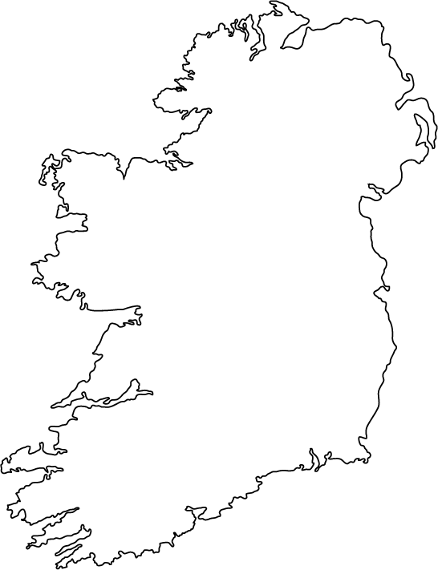
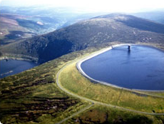
Motivation
Literature
Modelling framework
Results
Discussion
wastewater grid
electricity grid
Virtual storage node with fixed upper limit
wastewater inflow
wastewater inflow
Irish electricity node
electricity input
Wastewater treatment unit
wastewater outflow
Upper reservoir
Lower reservoir
Water body node without upper limit
electricity demand
*BOD: Biological Oxygen Demand

Slide 10
Motivation
Literature
Modelling framework
Results
Discussion

Slide 11
Motivation
Literature
Modelling framework
Results
Discussion
 | Literature shows that there is potential for demand response from WWTPs, connected to a reduction in energy costs
 | Participation in DR programmes can provide energy cost savings up to 15 percent by shifting loads from peak to off-peak periods (Aghajanzadeh et al., 2015).
 | Black-box WWTP model based on real energy audit data of Irish WWTPs indicates that there could be potential for load shifting
 | Virtual storage is used for flexibility: shift of wastewater processing to hours with low residual load
 | Extension of the analysis by developing an integrated energy systems approach which captures the WWTP process
 | Linearisation of the standard model required, work in progress

Slide 12
Thank you very much for your attention!
Acknowledgements
This publication has emanated from research conducted with the financial support of Science Foundation Ireland under the SFI Strategic Partnership Programme Grant Number SFI/15/SPP/E3125. The opinions, findings and conclusions or recommendations expressed in this material are those of the authors and do not necessarily reflect the views of the Science Foundation Ireland.

