Slide 1
Impact of Flexibility Service Requirements on Power System Investment Decisions and Costs
Ciara O’Dwyer
Damian Flynn
ESRI/UCD conference 17/09/2019

Slide 2
Introduction
New system services for the integration of a large share of RES?
Impact of flexibility service requirements on long-term power system investments
Importance of clear long-term signals for investors
Explicitly model flexibility service requirements within investment model
Impact on operating costs and curtailment levels

Slide 3
Investment models
Unit Commitment and Economic Dispatch models have evolved to handle high RES scenarios
Traditional planning models tend to lack temporal and operational detail
Value of flexible technologies and energy limited resources often not fully captured
Simplified representations overestimate potential uptake of RES and underestimate costs
Drive to close the gap between short-term UCED models and long-term investment models

Slide 4
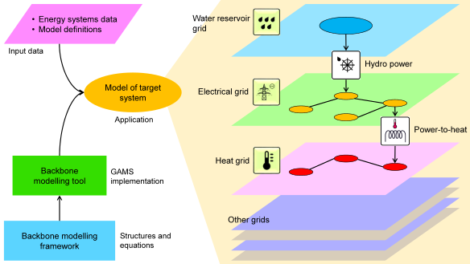
Backbone
Generic energy network optimisation tool
Highly adaptable model structure
Model based on parameter settings and input data
The same model structure can be used to define multiple models from the same data (investment model & scheduling model)
Representative time periods for investment analysis
Can employ a changing level of detail in the representation of operational constraints for the units (e.g. part-load efficiency).
Any number of reserve types

Slide 5
Backbone - reserves
N-1 reserves (previously fixed or time series)
Reserve capacity sharing allowed
Reserve provision from Turlough Hill
Offline reserve capability enabled

Slide 6
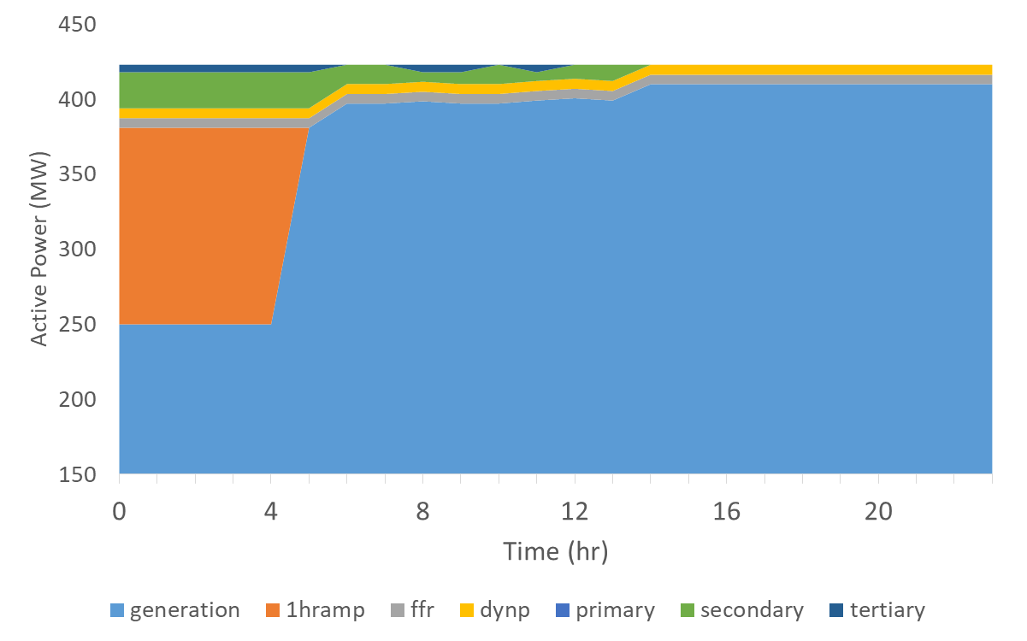
Backbone – reserve provision examples

Slide 7
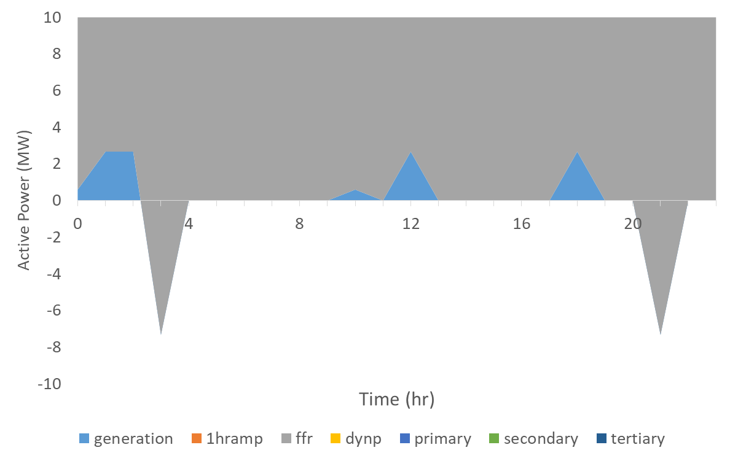
Backbone – reserve provision examples

Slide 8
Methodology
Focus on All-Island power system
Investment model feeds detailed scheduling model
Core generation portfolio established
Full complement of RES (Steady Evolution Scenario) included
Core portfolio well matched to Steady Evolution scenario, with the exception of the capacities for the investment options

Slide 9
Core plant portfolio
 | Steady Evolution 2030 | Core Investment Model
Coal | - | -
Gas | 5657 | 4100
Distillate / HFO | 389 | 389
Onshore Wind | 6678 | 6678
Offshore Wind | 700 | 700
Hydro | 237 | 237
Biomass | 487 | 487
Solar | 900 | 900
Pumped Storage | 292 | 292
Battery Storage | 550 | -
DSM | 500 | 500
DC Interconnection | 1650 | 1650
CHP or Waste | 290 | 290

Slide 10
Core plant portfolio
 | Steady Evolution 2030 | Core Investment Model
Coal | - | -
Gas | 5657 | 4100
Distillate / HFO | 389 | 389
Onshore Wind | 6678 | 6678
Offshore Wind | 700 | 700
Hydro | 237 | 237
Biomass | 487 | 487
Solar | 900 | 900
Pumped Storage | 292 | 292
Battery Storage | 550 | -
DSM | 500 | 500
DC Interconnection | 1650 | 1650
CHP or Waste | 290 | 290

Slide 11
Methodology
Investment options:
OCGT
CCGT
Grid-scale batteries
Three representative weeks selected based on random sampling
Objective function considers fuel and carbon costs, start costs and variable O&M and penalties
Unit constraints include min. gen. levels and min. operation and shut down hours
Inertial floor of 17.5 GWs enforced

Slide 12
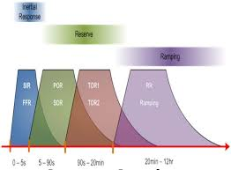
Methodology
Capacity margin of 1000 MW
Reserve Scenario | Description
A | No Reserve (Capacity Margin Included)
B | POR only
C | POR & FFR only
D | POR & 1 Hour Ramping Product only
E | POR, FFR & 1 Hour Ramping Product

Slide 13
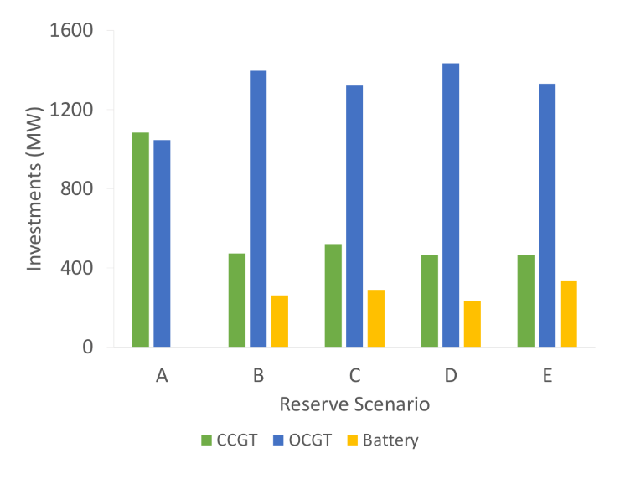
Results – investment model

Slide 14
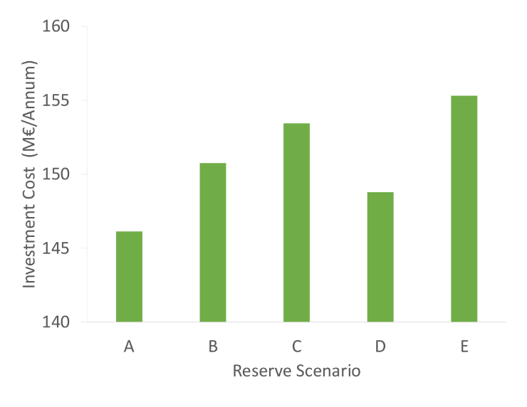
Results – investment model

Slide 15
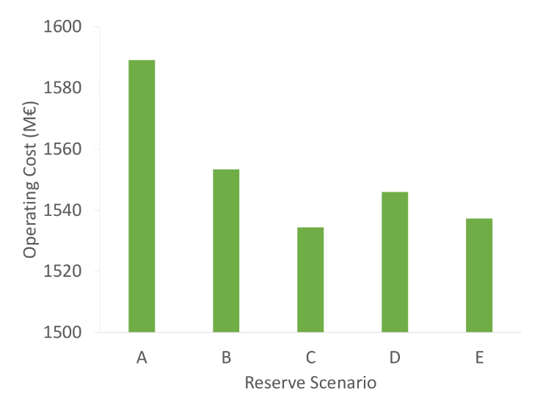
Results – scheduling model

Slide 16
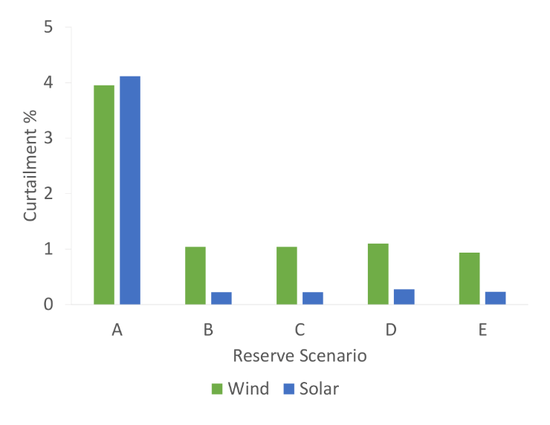
Results – scheduling model

Slide 17
Conclusions
Importance of operational detail in investment models
Inclusion of system services in investment models alters optimum plant portfolio
Importance of clear long-term signals for investors
Sub-optimal investments will lead to in increased operating costs and increased levels of curtailment and CO₂ emissions

Slide 18
Future work
Higher RES scenarios
Uncertainty surrounding input assumptions
Capital costs
Flexibility of conventional plant
System requirements for the new products
Representative weeks used in this work may not capture more extreme events

Slide 19
Impact of Flexibility Service Requirements on Power System Investment Decisions and Cost
Ciara O’Dwyer
Damian Flynn
ESRI/UCD conference 17/09/2019

