Slide 1


Electricity Distribution and Energy Decarbonisation
Prof. Andrew Keane
ESRI – UCD Workshop
17th September 2019

Slide 2
Context
Climate Action Plan places a large emphasis on electrification of energy demand (transport and heat) and integration of renewables
Increasing penetration of distributed energy resources (DER) at the distribution level
  Distributed Generation
  New loads (Electric vehicles, Solar PV, Heat Pumps)
System Services crucial to further integration of renewables (DS3 programme)
Market Opportunities for Demand response & DER to provide system services
  Particularly aggregators
  Services to support system operation, e.g. manage frequency
Infrastructure and operational challenges to be tackled
Distribution system is central to all of this

Slide 3



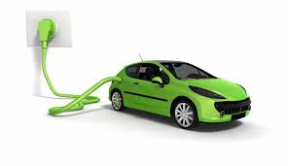

Evolving role of the DSO
Wide array of distributed energy resources are allowing and requiring changes in the way DSOs plan and operate the networks under their responsibility
What new roles must the DSO assume to adapt to the changing energy paradigm, while maintaining necessary quality of supply standards?
What new services can the DSO provide in the future in order to better support the energy markets?
What new tools/methodologies must be developed to support these new roles?
How must regulation and markets be adapted to support a cleaner and more efficient energy system in line with the new DSO role?
Notes:
…..

Slide 5
Future markets and regulatory frameworks should...
...Recognize the need and should provide incentives for possible innovative flexibility levers to be activated on distribution grid level.
Incentives
...Set clear rules for the recognition of the costs (both CAPEX and OPEX, over all timeframes) associated with innovative smart grid solutions
Cost recognition
...Continue to safeguard the availability of neutral, secure, cost-efficient and transparent data and information management on distribution grid level for all concerned stakeholders.
Data management
… Take national differences into account (no one-size-fits all) on the short to medium term, but strive for harmonization on the longer term;
Market Harmonization

Slide 6
Network Development Approach to date
Build more network (firm reinforcement)
  Gates for connection of renewables
  Group processing approach
UK innovation funding is driving changes in network operator practices
  OFGEM’s Low Carbon Networks Fund
Transition from R&D into Business as usual remains a challenge

Slide 7
Socioeconomic & Demographic Trends
Questions are no longer just technical questions
  Role of consumer and prediction of technology adoption highly relevant
Predicted erosion of demand diversity may happen in general
  But more critically it may also happen on a street by street basis
Huge complicating factor in terms of network planning and in terms of delivery of more ambitious concepts around smart grids and new business models

Slide 8
Current paradigm for distribution networks
Adoption of domestic-scale DER in residential feeders
  Lead to technical problems/risks
Lack of observability
  No widespread monitoring and communication equipment
Need for methods that enable real-time operation at the system’s edge
Voltage statutory limits violation
Assets overloading

Slide 9
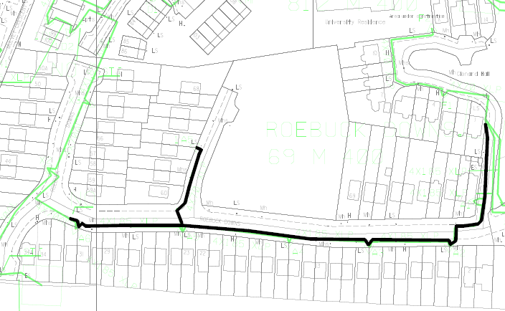
Sample Network
9

Slide 10

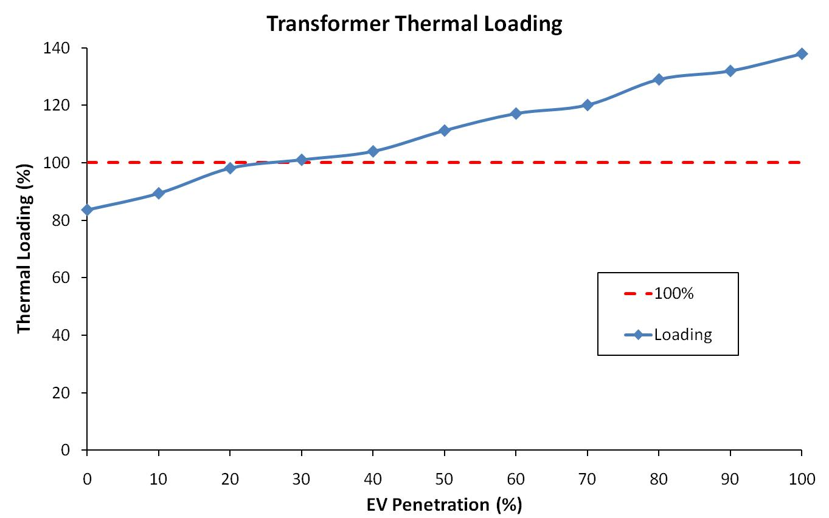


Deterministic Analysis of EV Impact (2011)

Slide 11
Limitations at the Distribution Level
No widespread monitoring
No widespread communication
More complex system modelling
Quick application
Convergence
Costly investment
Incompatible with real-time operation
Synchronization
Time resolution compatible with DER
Other (data privacy)
11

Slide 12
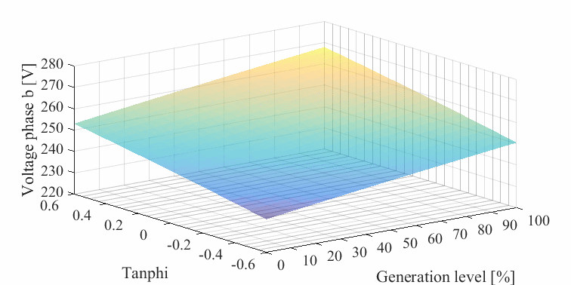
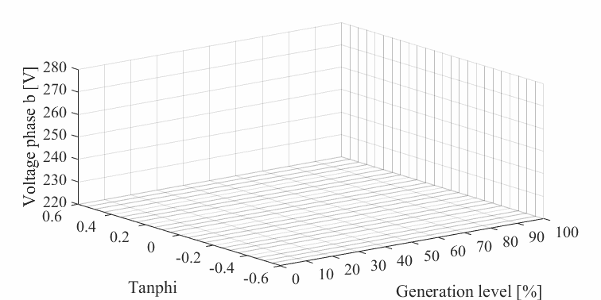
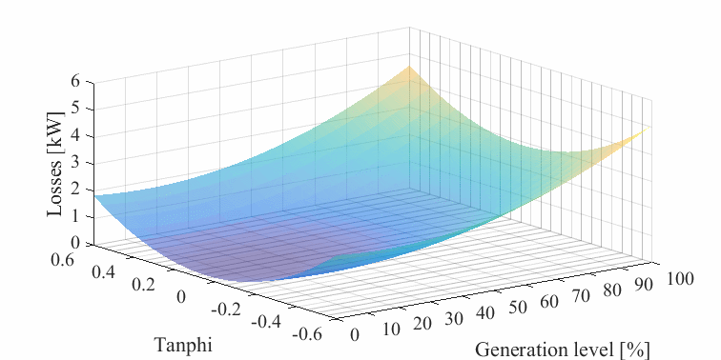
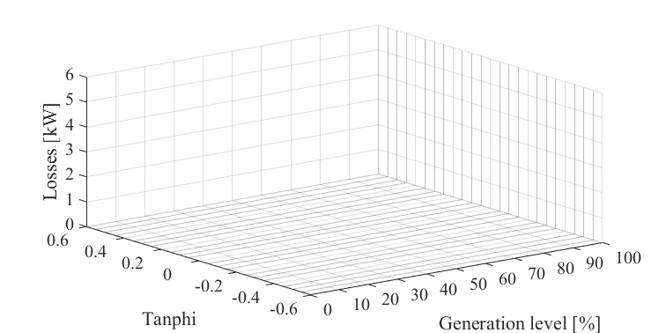
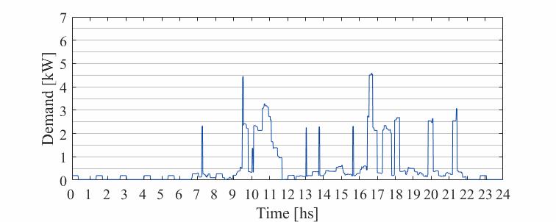
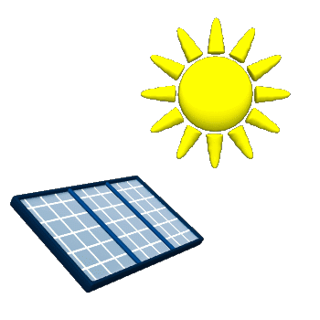

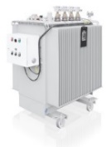
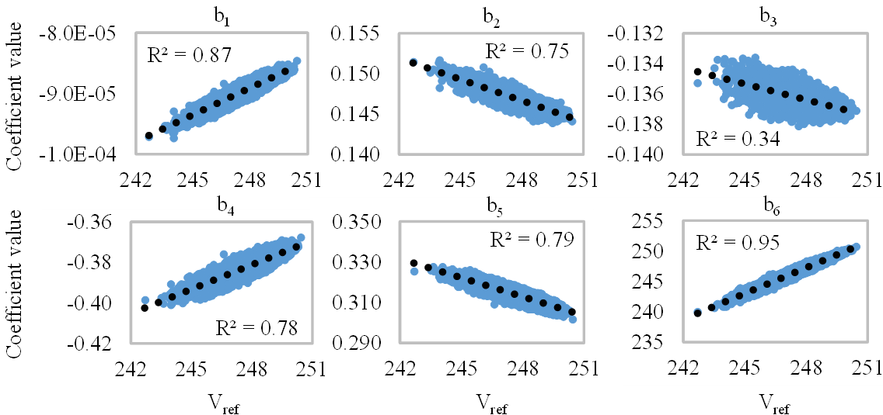
Network Characterisation – Curve Fitting
Optimized
control
Estimations
Notes:
Direct analytical solution

Slide 13
Test case
Remote CPOC
Estimating States here
Local CPOC
P,Q,V Measurements

Slide 14
Voltage estimations on daily simulation

Slide 15
PQ flows, losses and current estimations

Slide 16
Summary
System characterization at the point of connection of the DER
Monitoring is limited to local measurements (P, Q and voltage)
Direct (non-iterative) calculations for real-time operation
Information can be provided to, for example, demand aggregators, such that they can dispatch their resources without breaching network limits

Slide 17
Conclusions
Electrification of energy demand presents challenges to existing infrastructure
Integration of renewables presents similar challenges
  Reinforcement and new network management techniques required
Huge data and information gap will not be filled by comprehensive measurement sets in short term
Emerging view would be that distribution systems should now facilitate other stakeholders and business models for benefit of electricity consumer
For example, role of DSO in demand side services
  Facilitator
  Active management to enable other actors to participate in the market

Slide 18
Thank You
andrew.Keane@ucd.ie
www.ucd.ie/energy

