Slide 1
Deep Electrification of Residential Heating and Possible Implications
DATE
17th September 2019
VENUE
ESRI, Whitaker Square, Dublin
AUTHORS
Ankita Singh Gaur
Desta Fitiwi
John Curtis
Muireann Lynch

Slide 2
Acknowledgements
This work has emanated from research conducted with the financial support of Science Foundation Ireland under the SFI Strategic Partnership Programme Grant Number SFI/15/SPP/E3125. The opinions, findings and conclusions or recommendations expressed in this material are those of the author(s) and do not necessarily reflect the views of the Science Foundation Ireland.

Slide 3
Outline
Motivation
Objectives
Methodology
Assumptions and Scenarios
Results
Conclusion

Slide 4
Motivation
The residential sector accounts for a quarter of the energy used in Ireland
It is responsible for a quarter of the energy-related CO₂ emissions.
Source: SEAI, 2018

Slide 5
Motivation
In Ireland, domestic space heating was responsible for about 10 MtCO₂ emissions in 2016 (17% of the total emissions)
Source: SEAI, 2018

Slide 6
Motivation
Power-to-heat (P2H) with a thermal storage is a promising solution that helps countries such as Ireland to fulfil environmental goals
However, a higher penetration level of P2H could mean a dramatic increase in electricity demand, with this having implications on the existing grid infrastructures
Notes:
The new climate action plan released two weeks back mentions a target of installing 600,000 heat pumps in Ireland by 2030. 400,000 from retrofits and 200,000 from new builds.

Slide 7
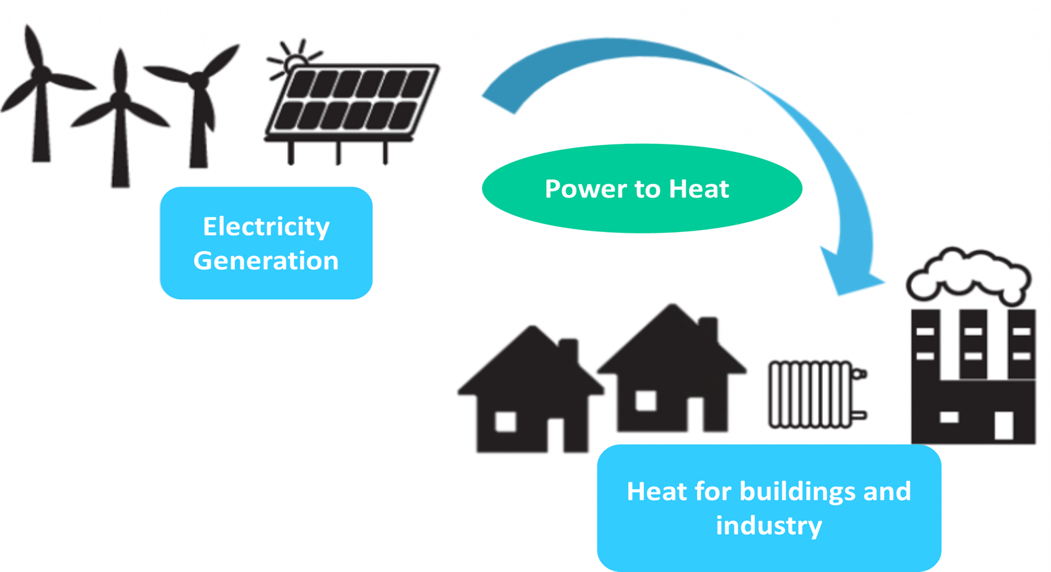
Objectives
Develop an optimization framework that enables understanding the interactions between the power and the heating sectors for the Irish transmission grid
Provide a quantitative as well as qualitative analysis on the impacts of P2H (Air Source Heat Pumps) in terms of grid and power generation expansion needs as well as overall system performance

Slide 8
Methodology
The Electricity Network and Generation INvEstment (ENGINE) model is used
Determines the least-cost development of power systems in Ireland and beyond.
Policy Measure
Uncertainty & Variability
Technology & demand data
Network & generation data
Heat sector data
Inputs
Developed in ESRI
Electricity Network & Generation INvEstment Model
Development
ENGINE
Optimal power generation mix
Grid expansion outcomes
Impact analysis
Comparative analysis
Interaction of flexibility options
Linearised AC optimal power flow model
Least cost optimization
Stochastic programming framework
Coded in GAMS
Outputs
Methodology

Slide 9
Methodology
Electrification of heat demand via heat pumps will increase the overall demand for electricity, challenging the existing power system infrastructure
The aim is to obtain a least-cost transmission system when the heat demand is electrified
ENGINE
E-Heat Model
Integrated Power system and E-heat model
$$+$$
Heat demand balance
Thermal losses
Thermal energy storage balance
Other Constraints
Capacity of heat pump
Limits on storage levels
Charge/discharge limits of storage

Slide 10
Case Studies
Case-1: Impact of electrifying new housing developments
Case-2: Impact of retrofitting old housing stock

Slide 11
Case-1

Slide 12
Assumptions and Scenarios
The transmission system consists of 676 supply and demand points connected by 900 transmission lines and transformers
Heat pump (HP) capacity- 1.504 kW, Thermal energy storage (TES) capacity- 50 kWh
Heat pumps are installed in new, well insulated buildings and housing developments

Slide 13
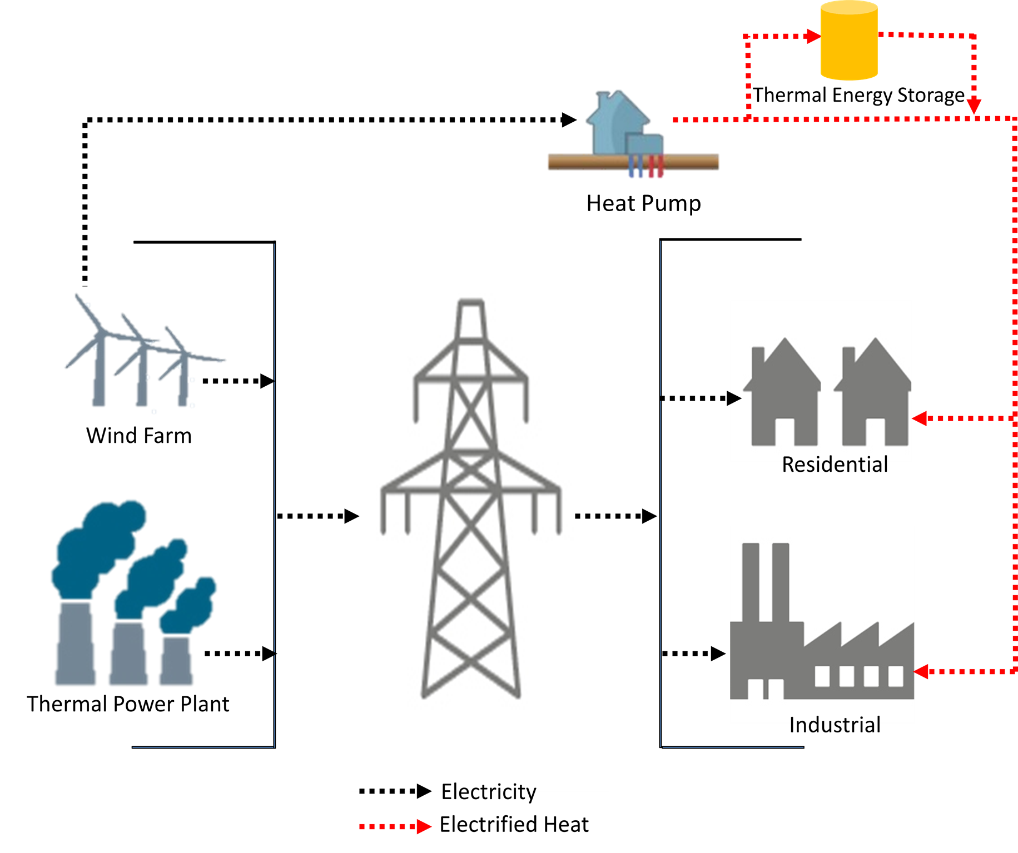
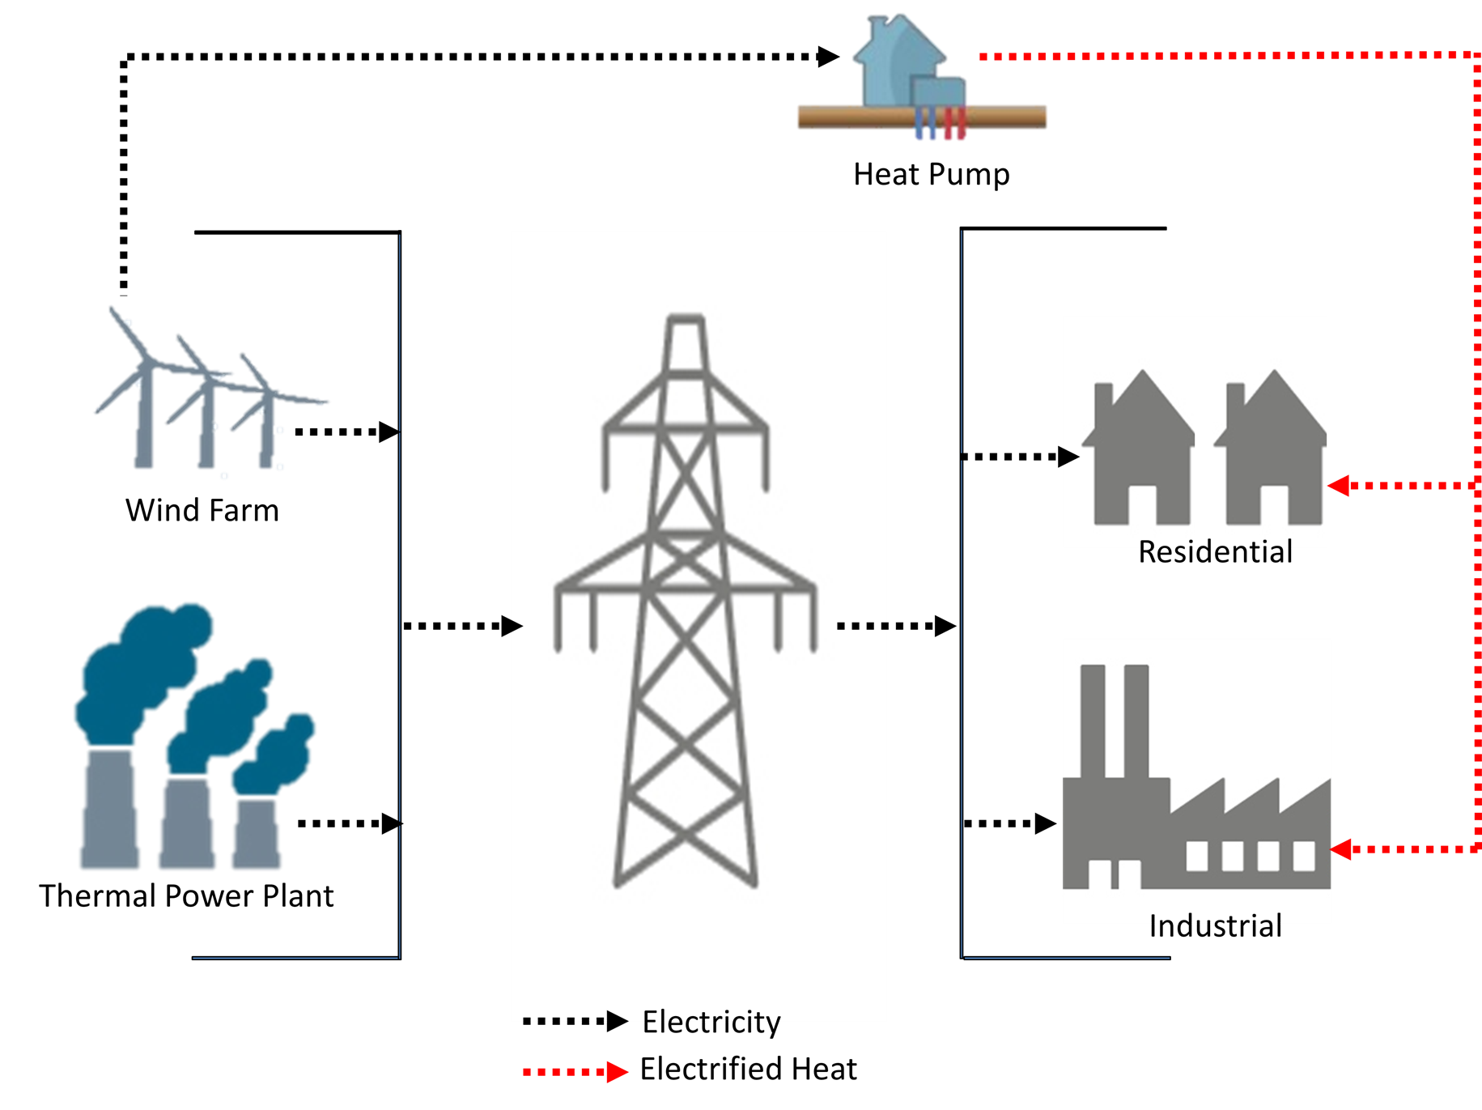
Assumptions and Scenarios
The analysis in this work considers 3 cases designated as:
Business as Usual (BaU)
Direct E-Heating
E-Heating with TES
Direct E-Heating
E-Heating with TES

Slide 14
Assumptions and Scenarios
In line with EirGrid’s projections, two e-heating demand growth scenarios are simulated, “Low E-Heating Scenario” & “High E-Heating Scenario”

Slide 15
Results
Additional electricity transmission capacity is required with HP penetration; however, using TES can reduce this requirement
Notes:
With the “Direct E-Heating” case in the “Low E-Heating” scenario, it can be observed that partly electrifying the heat demand increases transmission expansion requirements by 2.5% compared to that of the BaU scenario. However, if this is done along with thermal energy storage, compared to that of the BaU case, the network needs to only be expended by 0.58%, expressed in terms of additional transmission line capacities in the system. A similar trend can be observed in the “High E-Heating” scenario in which the “Direct E-Heating” case requires 5.3% more transmission capacity than in the BaU scenario, while in the “E-Heating with TES” case requires 4.3% new transmission capacity in the system. This explains the advantages of installing heat pumps along with thermal energy storage devices to reduce the transmission capacity needs.

Slide 16
Results
Heat pumps enable a more efficient utilization of variable renewable power

Slide 17
Results
Heat pumps cause additional power generation, and hence there is an increase in emissions
With TES the emissions are lower due to load shifting

Slide 18
Results
Excess variable renewable energy (mainly wind) is stored during low-demand periods, and released when the heat demand is high and the wind energy is not available

Slide 19
Case-2

Slide 20
Assumptions and Scenarios
Heat demand consists of 2 parts:
heat demand arising from new builds using heat pumps for domestic heating
heat demand from old houses retrofitted by 2030
Data on existing housing stock is taken from the Central Statistics Office (CSO), Ireland (2016 Census data)
The analysis considers two scenarios for nine different values of thermal heating costs (THC)
As thermal heating costs rise, electrification of heat increases, which increases demands on the power system

Slide 21
Results
It is far more economical to electrify residential heating when using TES as compared to the “Direct” case
Notes:
In the ”direct” scenario, changes in the penetration level of e-heating are not significant for a penalty factor setting of 80 e/MWh or lower. Only beyond this threshold does the adoption of e-heating make more economic sense. Whereas, when thermal storage systems are deployed as in the second scenario, the
percentage of demand met via e-heating increases significantly from 40 e/MWh onwards. This implies that it is far more economical to electrify residential heating when using TES as compared to the other case. Such a dramatic difference between the two scenarios is explained by the fact that the peak electrical and heating demands mostly happen during the same time periods. Hence, serving the heat demand becomes exorbitantly expensive in the ”direct” scenario. But with TES, excess RES energy (that would otherwise be curtailed as in the ”direct” scenario) is stored during periods of low heat and electrical demand and released during high demand and low RES power production periods.

Slide 22
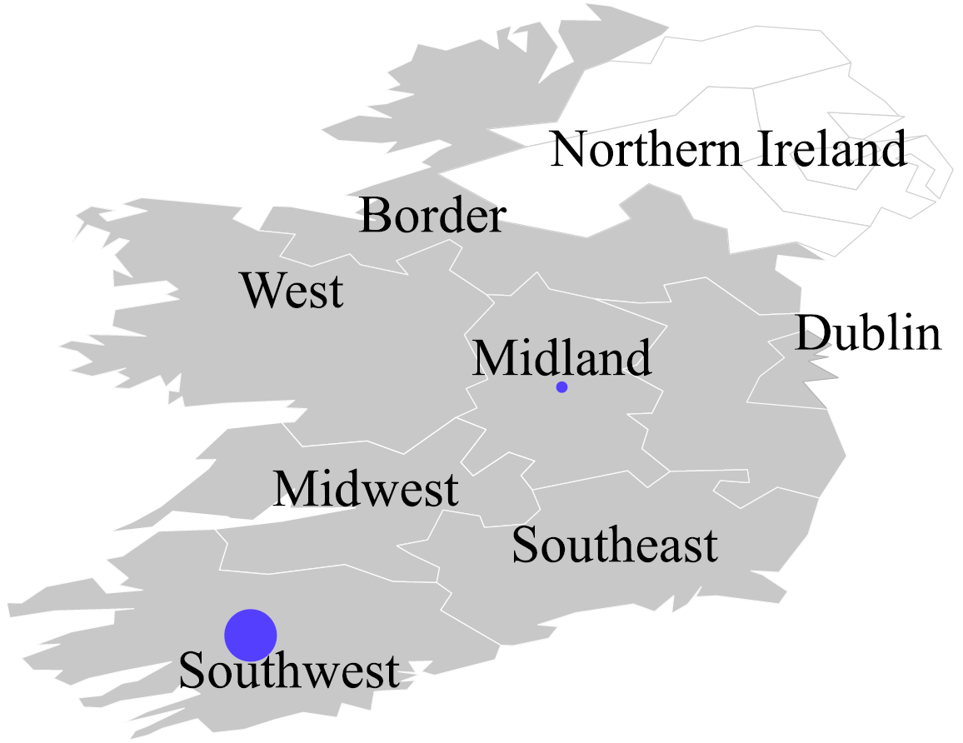
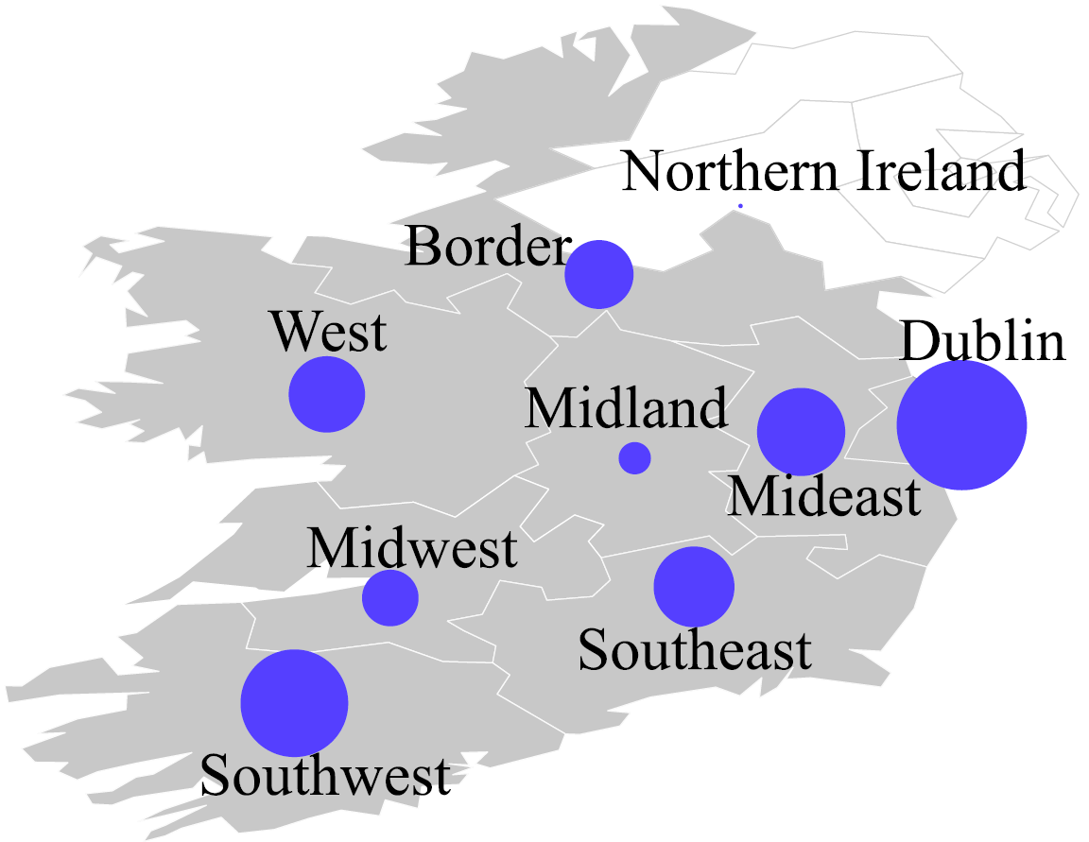
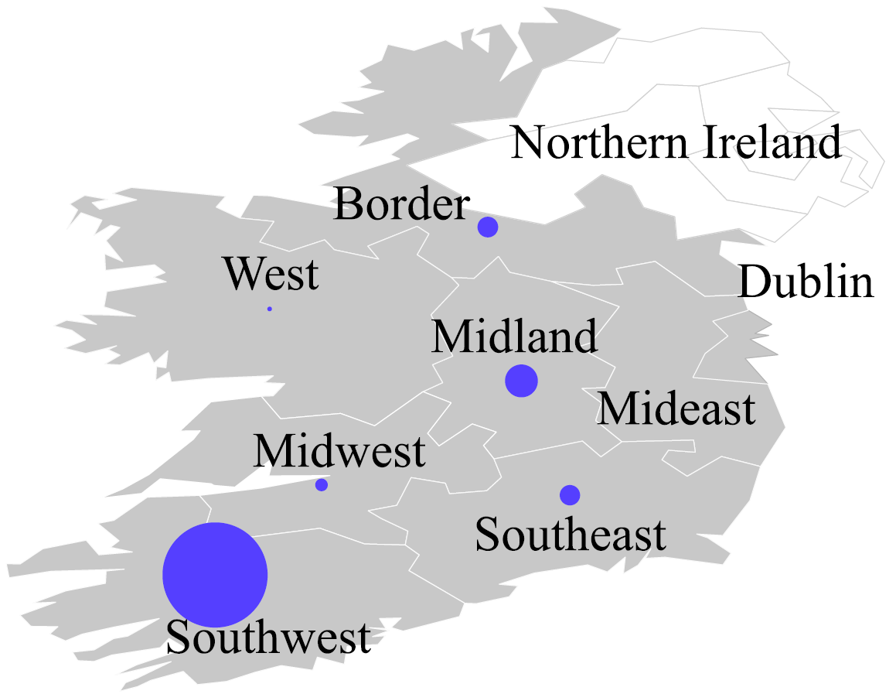
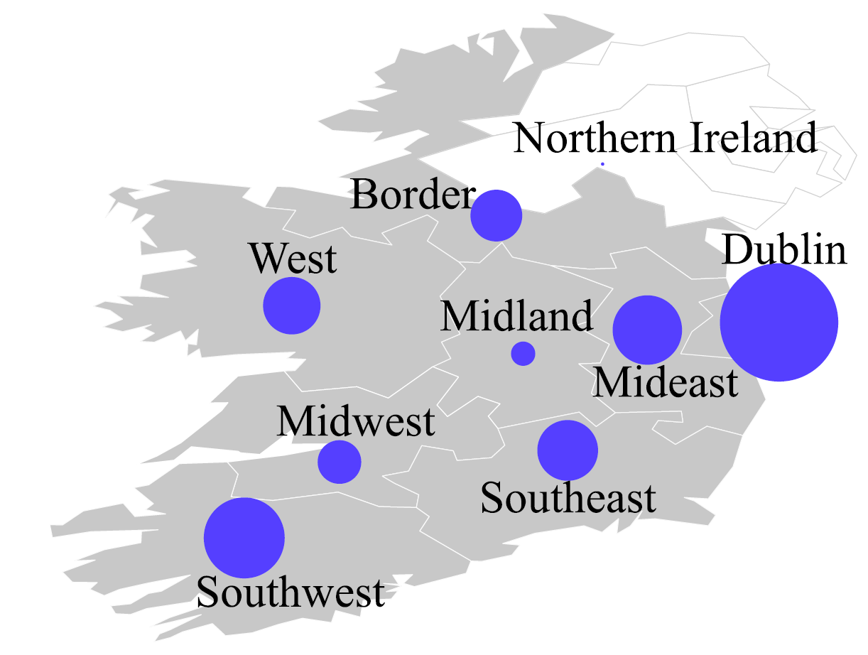
Regional distribution of optimally electrified houses
THC =80 (€/MWh); Direct
THC =200 (€/MWh); Direct
THC=30 (€/MWh); With TES
THC=80 (€/MWh); With TES
Notes:
the regional distribution of electrified houses is largely determined by the location of wind energy potential and network constraints. This is particularly
relevant in the case of ”direct” scenario. The results generally reveal that the co-deployment of TES leads to a substantially reduced network stress and enhanced system-wide flexibility, the combination of which enables a higher penetration level of e-heating throughout the island.

Slide 23
Results
Grid reinforcement needs is lower with TES
Notes:
At low levels of thermal heating costs, the expansions are similar since there are no investments in retrofits. At medium levels, there is investment only in TES case, hence there is higher expansion need. It is more economical. Also, the grid expansion is only slightly higher although electrification levels are higher. At higher levels of thc, higher electrification and hence higher capacity needed.

Slide 24
Results
Wind energy curtailment is substantially reduced with TES, leading to a more efficient utilization of available clean energy sources

Slide 25
Conclusions
Electrifying the heating sector considerably increases grid expansion needs in the system.
However, the impact highly depends on the growth of heat demand, and the extent of heating sector electrification
Electrification of heating sector enables a more efficient utilisation of variable renewable power, reducing variable power curtailments
It is deemed economical to electrify more houses located near RES-rich places
TES plays a major role in heat sector electrification by:
Reducing grid investment needs
Reducing RES curtailment
Enabling higher electrification at lower PFs

Slide 26
Thank You
Questions?

