Slide 1


Attitudes to Renewable Energy Technologies:
Driving Change in Irish Households
Sanghamitra Chattopadhyay Mukherjee
School of Economics & Energy Institute, UCD
Co-authored by: Tensay Hadush Meles (UCD), Lisa Ryan (UCD), Sein Healy (Amárach Research), Robert Mooney (Amárach Research) & Lindsay Sharpe (ESB Networks)
17 September 2019
UCD-ESRI Conference, Dublin

Slide 2
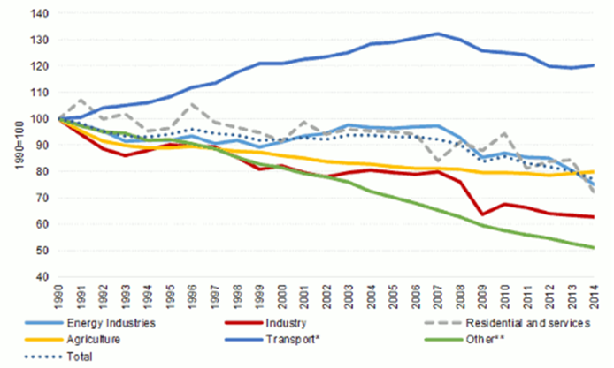
GHG emissions from transport are rising
Transport accounts for about 25% of EU GHGs and is the major source of urban air pollution.
Unlike other sectors, emissions have not
seen a definitive downward trend yet.
Road transport accounts for over 70% of
the emissions from the transport sector.
Source: EEA

Slide 3
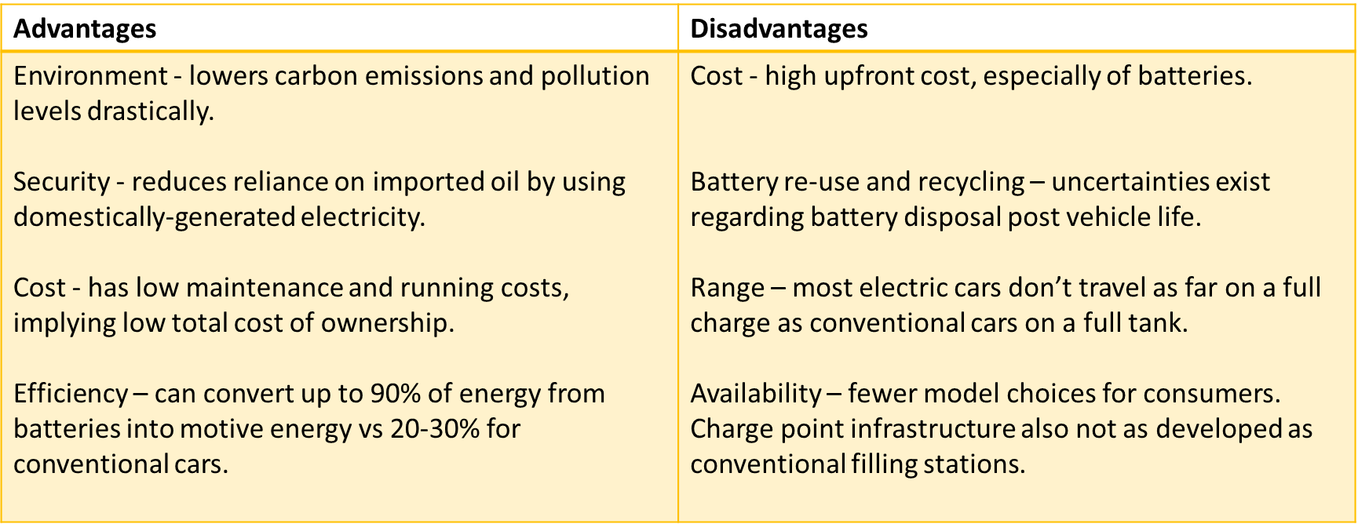
Pros of electric vehicles (EVs) outweigh cons

Slide 4
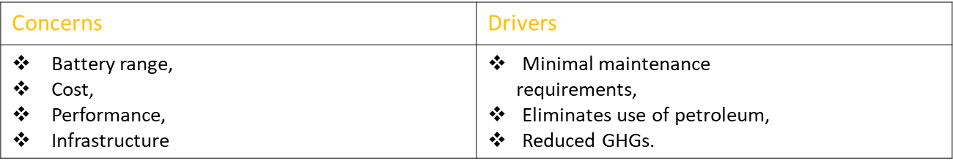
Early adopter studies have been growing
Egbue & Long (2012) surveyed technology enthusiasts in the US.
Plotz et al. (2014) sample early EV adopters & non-adopters who intend to adopt in Germany.
  Adopters primarily
    middle-aged,
    male,
    of high socio-economic status,
    living in rural areas with several household members, often children,
    interested in trying out technical innovations,
    less concerned with comfort.

Slide 5
But characteristics are not well established
Curtin et al. (2009) survey a representative U.S. sample.
  Gender & location are not clear predictors.
Sierzchula et al. (2014) conduct a multi-national study.
  Charging infrastructure is the best predictor of a country's EV market share.
Graziano & Gillingham (2015), Darshing (2017), Palm (2017) analyse secondary datasets spatially.
  Peer effects affect regional PV uptake in the US, Germany & Sweden.
Notes:
One new adoption increases the number of solar PV adoptions in a block group per year-quarter. This effect diminishes with distance and time.
Regional PV uptake follows patterns of solar radiation, demographic characteristics, and spatial dependence across neighbouring regions, due to peer effects, local craftsmen or solar initiatives.
Active peer effects are more important & propagate through existing social networks rather than via neighbours who do not already know each other.

Slide 6
We identified seven determinants of uptake
Economic
Intangible
Technical
Socio-demographic
Behavioural
Psychographic
Spatial & built environment

Slide 7
Research question?
Conflicting evidence on factors characterising early adopters.
Use Irish data to model future uptake of electric vehicles, solar panels and heat pumps.
More evidence needed on the Irish market.

Slide 8
New technology adoption is in early stages
Only 23 EVs in 2010 → cumulative uptake of 1,759 by 2016.
  1,179 of these adopted in 2015 and 2016 alone.
Count of adopters | No. of Small Areas
0 1 2 3 4 5 15 | 16892 1520 183 34 9 2 1
Source: ESB ecars data.

Slide 9
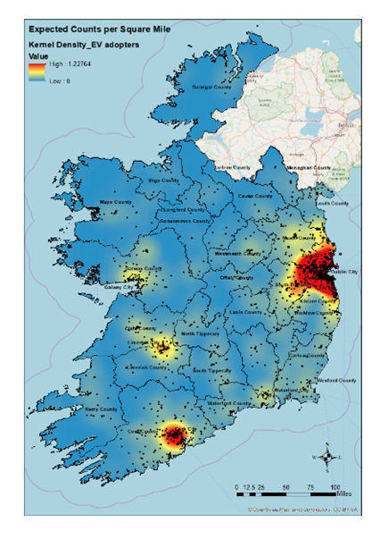
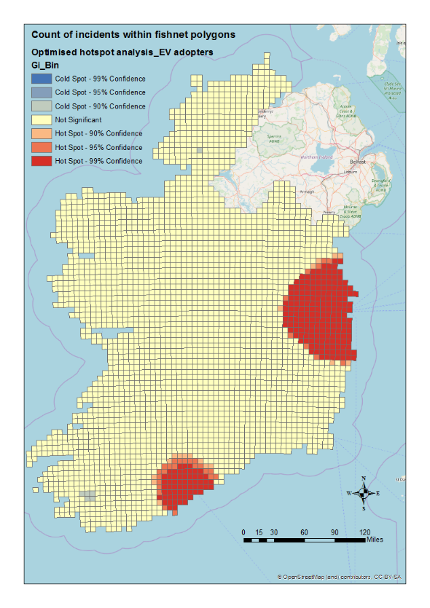
Heat maps show geographic clusters
Adopters mainly cluster around major urban centres - Dublin and Cork.
We combine CSO census data & ESB ecars to create our dataset.
Source: Author's illustrations using ESB ecars data.

Slide 10
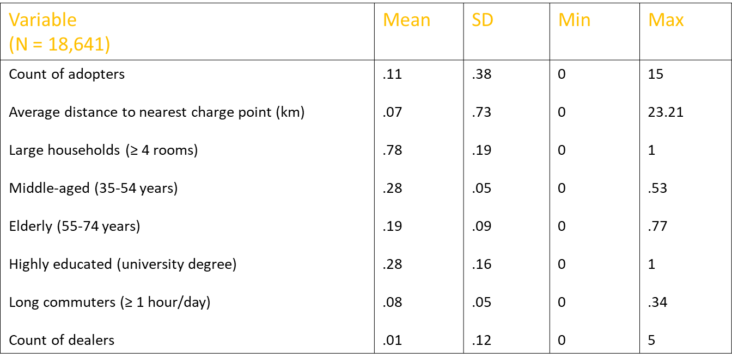
Summary statistics
NB. Socio-demographic variables are normalised by population in each small area.

Slide 11
Econometric analyses add to evidence base
Poisson & negative binomial models appropriate for non-normal count data.
Significant variables in order of importance:
  Long commuters.
  Large households.
  Dealer count.
  Elderly population.
  Average distance to nearest charge
  point.
EV owners cluster around populous urban centres.
More EV adopters in neighbourhoods of
  high socio-economic status,
  perhaps in suburbs with long commute time,
  large houses,
  relatively younger population,
  presence of dealers, and
  longer distances to public charge points.

Slide 12
Revisit slide 6
Economic
Intangible
Technical
Socio-demographic
Behavioural
Psychographic
Spatial & built environment

Slide 13

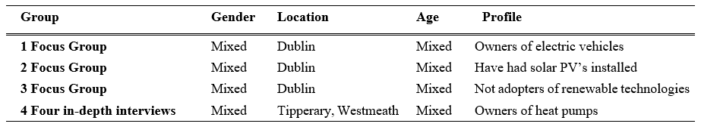
Focus Groups
Notes:
The purpose is to understand how people feel or think about a product, service, idea, or issue.
Six to eight people are selected because they have something in common.
The sessions involve a skilled moderator creating a comfortable, permissive environment to lead a series of carefully planned discussions.

Slide 14
Online survey complements real-world data
We collect granular preference data using nationally-representative sample.
  3 groups of 400 adult participants, for solar panels, heat pumps and EVs.
  Random sample from market research panel stratified on age, gender, region and social class.
  Socio-demographic data, risk and time preferences, attitudinal variables e.g. towards new technology & the environment.
  Discrete choice experiment (DCE) to identify key criteria in the renewable energy technology (RET) adoption process.

Slide 15
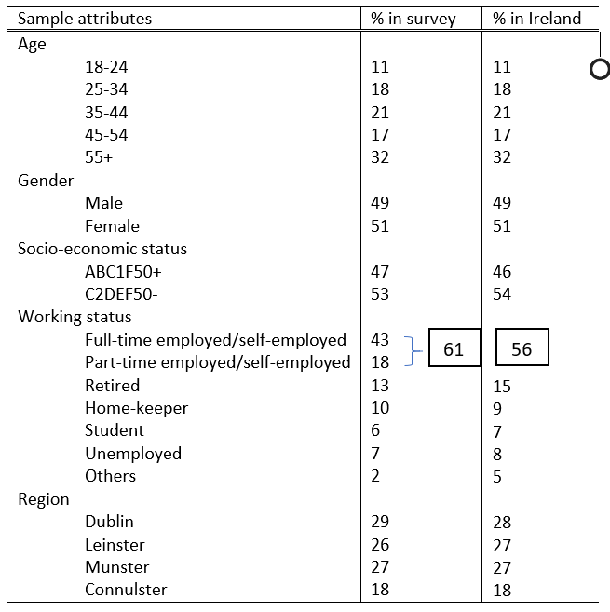
Demographic profile vs. national statistics
National statistics are largely aligned with sample characteristics.

Slide 16
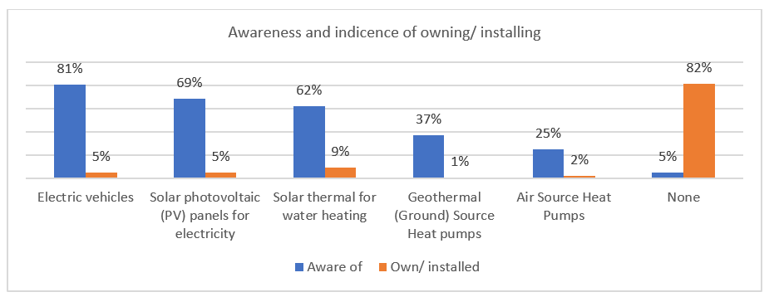
Awareness of RETs is quite high

Slide 17
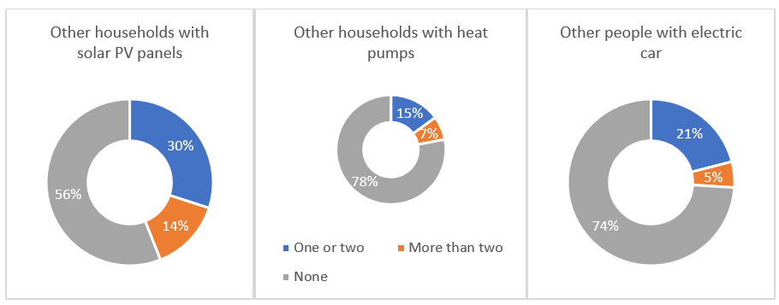
Awareness of other owners is relatively poor

Slide 18
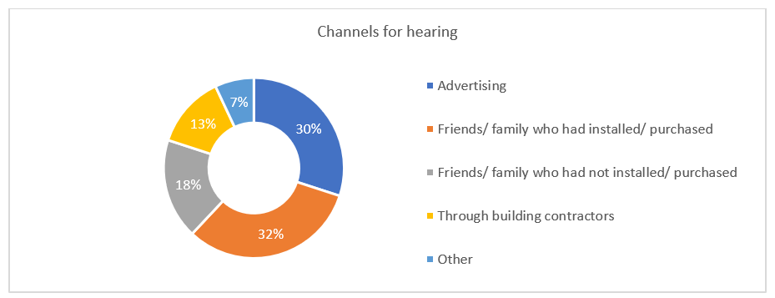
Social networks & adverts are key communication channels

Slide 19
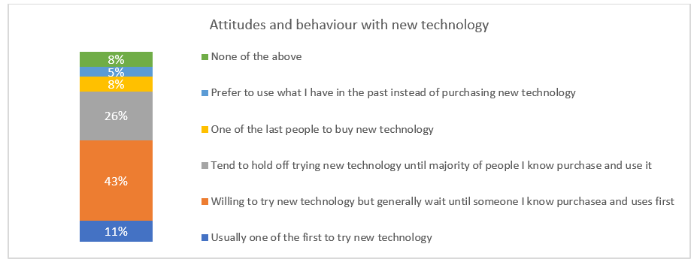
Most people adopt a wait-and-see approach

Slide 20
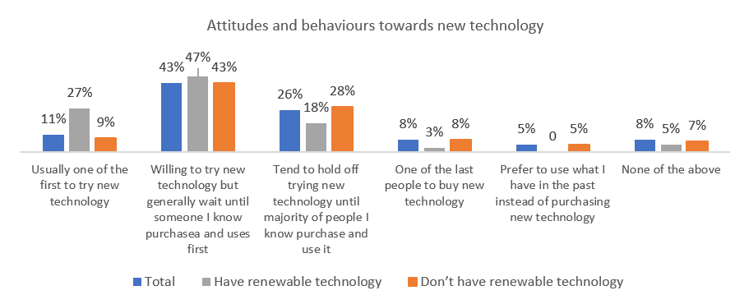
Current adopters tend to be innovators

Slide 21
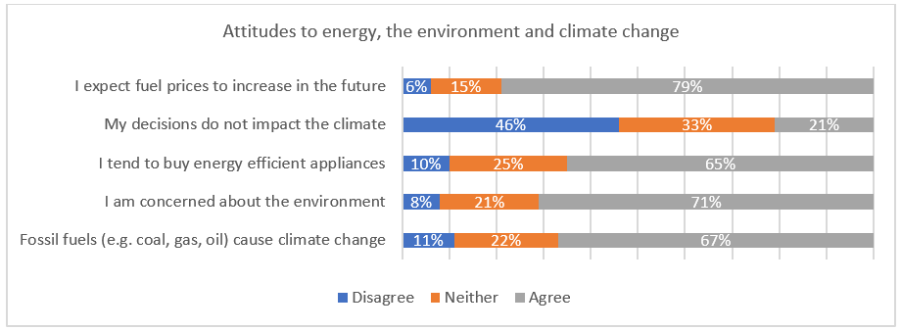
Most people care about the environment

Slide 22
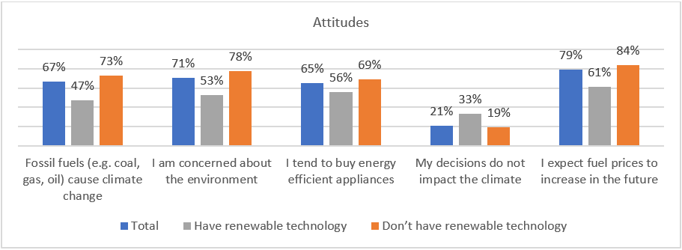
Non-adopters tend to care even more!

Slide 23
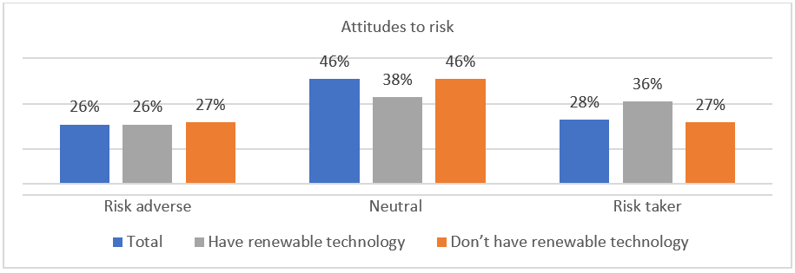
More adopters report being risk-takers

Slide 24
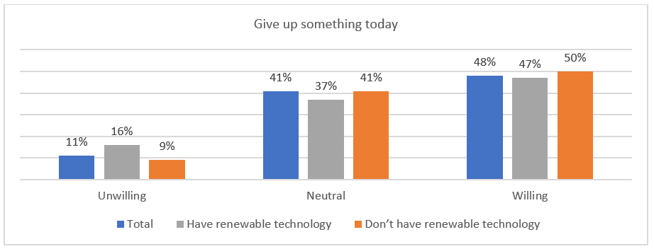
Most seem forward looking but adopters less so and present bias exists

Slide 25
Evidence from pairwise t-tests closely resembles our econometric results
Adopters (n=203) & non-adopters (n=1005).
Adopters are
  Younger
  Male
  Employed full time
  Higher socio-economic status
  Live in newer residences, large size/families
  Have higher energy use
  Larger social networks
  More aware of RET, willing to take risks, present biased, take personal responsibility.
Policy implications.
Can create typology of households to predict near future geographic uptake.

Slide 26


Slide 27
A few policy implications…
Monetary incentives are most important, especially in the short term.
Attitudes towards sustainability not sufficient predictors of uptake → policies must help translate attitudes into pro-environment behaviour.
Better understanding of specific technology will help defuse uncertainty & inertia.
Inclusive non-monetary benefits help ensure benefits pertain to the long term → e.g. public charging network for EVs.

Slide 28
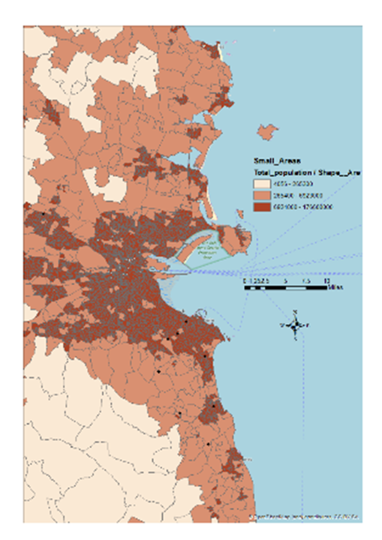
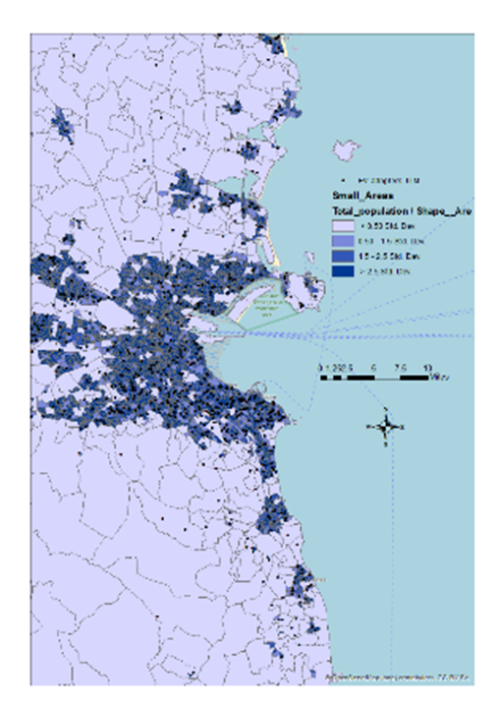
High adoption areas appear to be close together in current policy scenario
EV adoption in Dublin moved from south to centre-north between 2011 & 2017.
Introduction of €5,000 purchase grant, lower road tax of €120, zero rate of Vehicle Registration Tax (VRT) relief of up to €5,000.
Source: Author's illustrations using ESB ecars data.

Slide 29





Questions?
Thanks for your attention!
  Thanks to ESB networks, Amárach Research, the Irish Research Council and Science Foundation Ireland for their collaboration and/or for funding this work.

