Slide 1

A Low Carbon Future of Transport: an Integrated Transport Model Coupling with Computable General Equilibrium Model
Shiyu Yan
(Economic and Social Research Institute, ESRI, Ireland)
Kelly de Bruin (ESRI), Emer Dennehy (SEAI)
ESRI-UCD energy research conference. 2019/09/17

Slide 2
Content
1. Introduction
2. Methods
3. Results
4. Conclusion

Slide 3
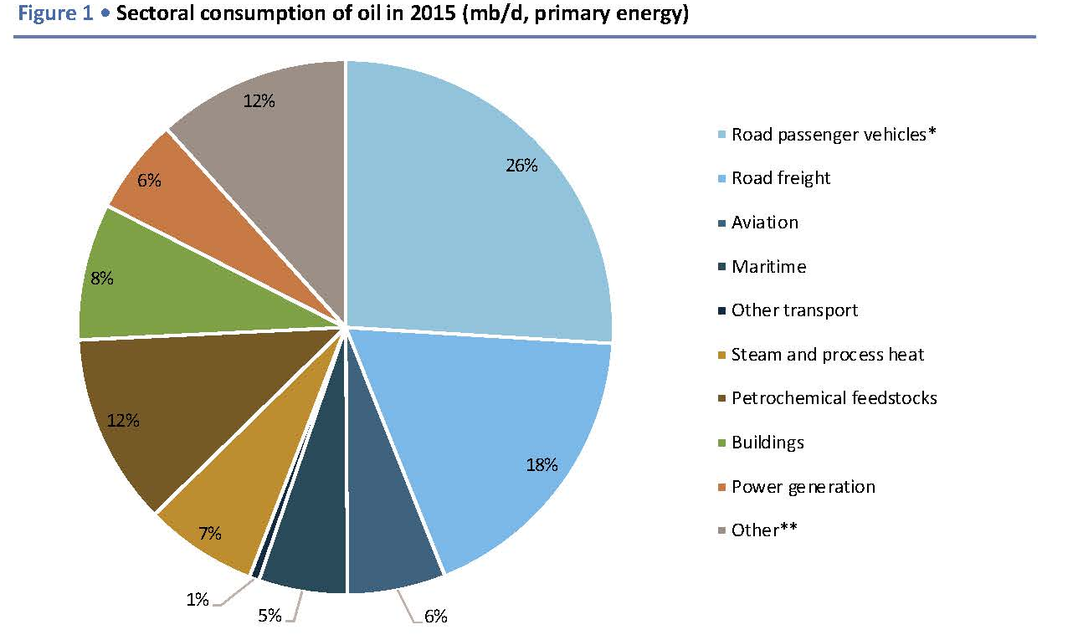
The importance of transport sector
1. Introduction
IEA(2016)

Slide 4
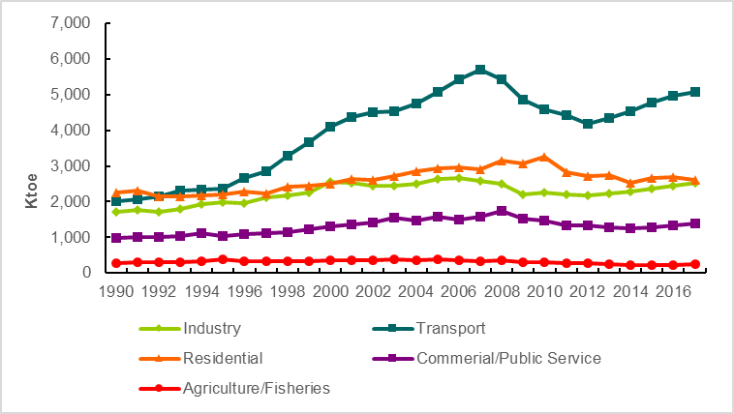
1. Introduction
Total final energy consumption in Ireland by sector

Slide 5
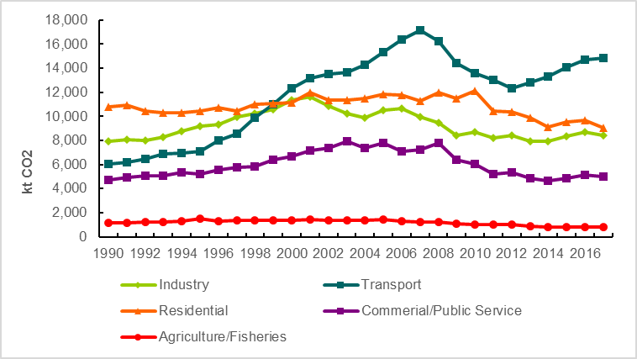
1. Introduction
Energy-related CO2 emissions in Ireland by sector

Slide 6
1. Introduction
The project objective is to establish a integrated model of transport demand, energy consumption and emission to improve decision making in the sustainable transition of transport sector.
quantify impacts of external socio-economic developments;
evaluate effects of policy packages on transport and other economic activities;
provide tools for decision makers to calculate transport energy and emission;
present detailed transport energy scenarios in modal and technologies.

Slide 7
- Macro-economic and energy system wide top down models – bottom up approaches with sectoral details.
Global Change Assessment Model (GCAM) (Mishra et al., 2013)
UK transport carbon model (Brand et al., 2012)
- Panel data for parameter estimation and simulation
- Integration of behavioral realism (logit models)
- Link the transport (energy) model with a general equilibrium model (I3E)
1. Introduction
Research contributions:

Slide 8
2. Methods
An integrated modelling framework
Transport activity, energy, and emission
passenger (Car, bus, rail, air) and freight (LGV, HGV, rail, navigation and air)
Freight transport demand (tkm) and freight vehicle stock

Slide 9
Number of vehicles by class and technology
I3E Model
Scenario variables
(e.g. GDP, income, demographics, prices)
Vehicle Stock Module
(new sales, scrapped vehicles)
Transport demand by mode and vehicle class
Transport Demand Module
(forecast and disaggregation)
Fuel Consumption Module
(aging, on-road and driving condition)
Energy use by fuel type
Policy variables
(e.g. vehicle taxes, energy taxes, carbon taxes, energy targets)
Emission Module
(GHG and other pollutants)
In-use and life-cycle emissions by pollutants
Transport Model

Slide 10
2. Methods
2.1 Freight Transport Demand Module
2.2 Freight Vehicle Stock Module
2.3 Freight Vehicle Fuel Consumption/Emission Module

Slide 11

2. Methods - Transport Demand Module (freight)
Freight transport
Total transport service demand (tkm)
Rail
Road
Diesel
Petrol
Others
Demand Share
Discrete choice model
10 weight bands
Weight band LGV1
… …
Weight band HGV5
Weight band LGV1
… …
Weight band HGV5
Generalized price (euro/tkm)
Vintage 1999
…
Vintage 2050
… …
… …
… …
52 years of registration

Slide 12
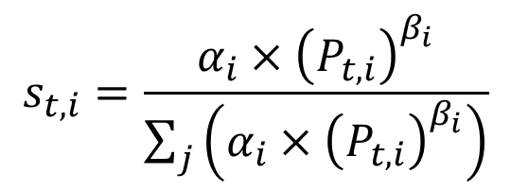
Total transport service demand (tkm) - Discrete choice model
2. Methods - Transport Demand Module (freight)
Transport service price (euro/tkm)
$$s_{t,i}=\frac{α_{i}×{\left(P_{t,i}\right)}^{β_{i}}}{\sum_{j}{\left(α_{i}×{\left(P_{t,i}\right)}^{β_{i}}\right)}}$$
Share of total transport service demand (tkm) by mode/technology, i.
t is year
𝛽 is estimated from regression
𝛼 is calibrated for the baseline year 2015

Slide 13
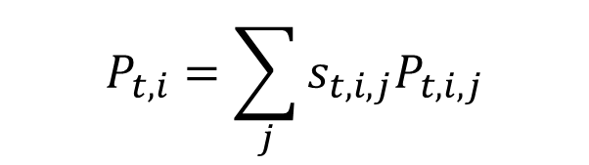
Generalized price
2. Methods - Transport Demand Module (freight)
A generalized price is a share-weighted average price that is aggregated from prices on the lower level, j, in the nested structure based on the transport service demand share of vehicle technologies.
$$P_{t,i}=\sum_{j}{s_{t,i,j}P_{t,i,j}}$$
Road - Vehicle price, vehicle taxes, fuel costs and other costs.
Rail – Revenue/distance

Slide 14
2. Methods - Vehicle Stock Module (freight)
Transport service demand by fuel, weight band and year of registration
New vehicles
Freight vehicle stock
Old vehicles
Survive rates by weight band and age

Slide 15
Energy efficiency by mode, fuel type, vehicle weight and year of registration
2. Methods - Vehicle Stock Module (freight)
Old vehicle energy efficiency (litre/km) increases along with the age. (LGV and HGV)
New vehicle energy efficiency decrease considering the euro standard for vehicles. (LGV and HGV)

Slide 16
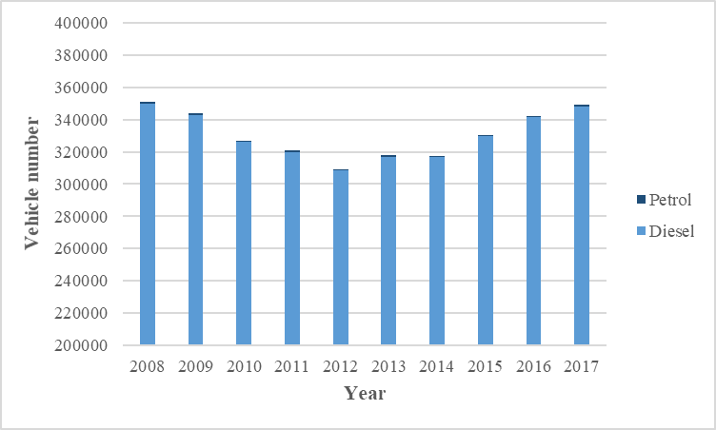
2. Results (Preliminary) - Descriptive analysis

Slide 17
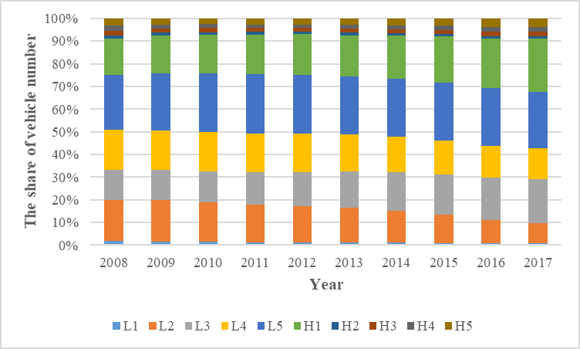
2. Results (Preliminary) - Descriptive analysis
L1: <1017 kg
L2: 1017-1270
L3: 1271-1524
L4: 1525-1778
L5: 1779-2032
H1: 2033-5080
H2: 5081-7112
H3: 7113-10160
H4: 10161-12192
H5: >12193

Slide 18
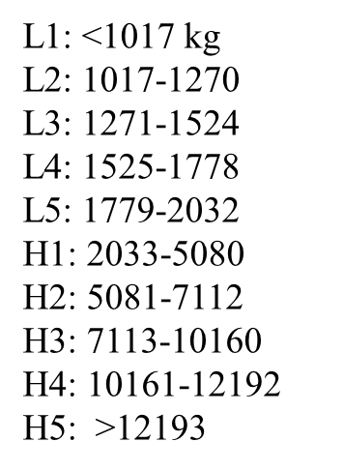
2. Results (Preliminary) - Descriptive analysis
New vehicle survival rate

Slide 19
2. Results (Preliminary) - Descriptive analysis
New vehicle energy efficiency

Slide 20
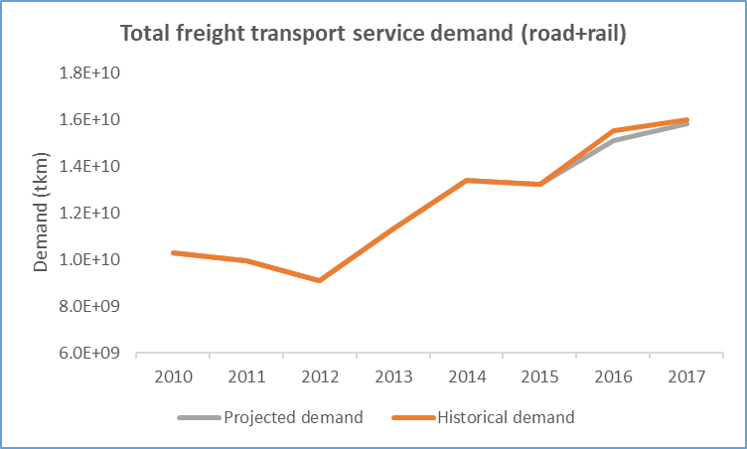
Total freight transport demand (tkm)
2. Results (Preliminary) - Projection
Base year

Slide 21
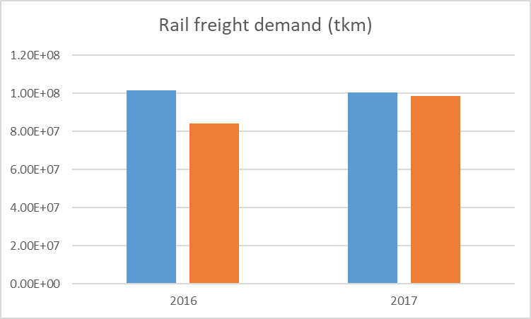
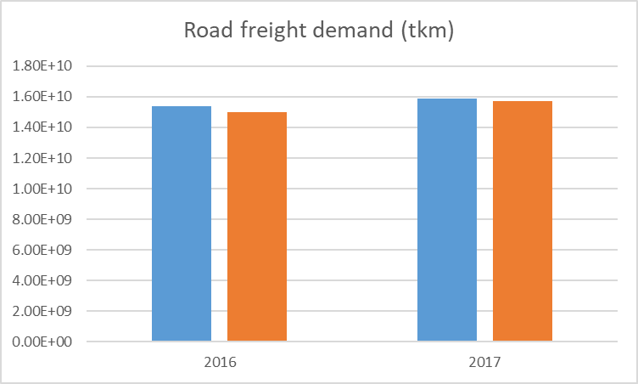
Total freight transport demand by transport mode (tkm)
2. Results (Preliminary) - Projection

Slide 22
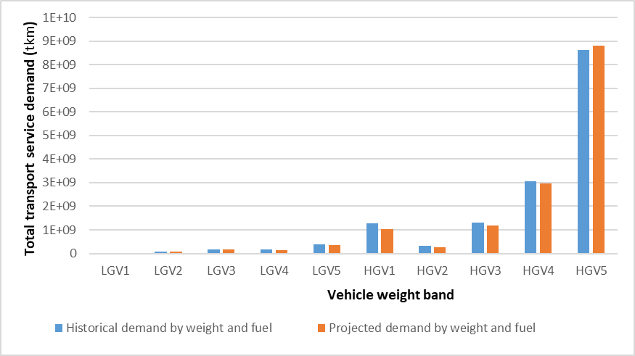
Total freight transport demand by vehicle weight and fuel (tkm)
2. Results (Preliminary) - Projection
Year of 2016
Diesel

Slide 23
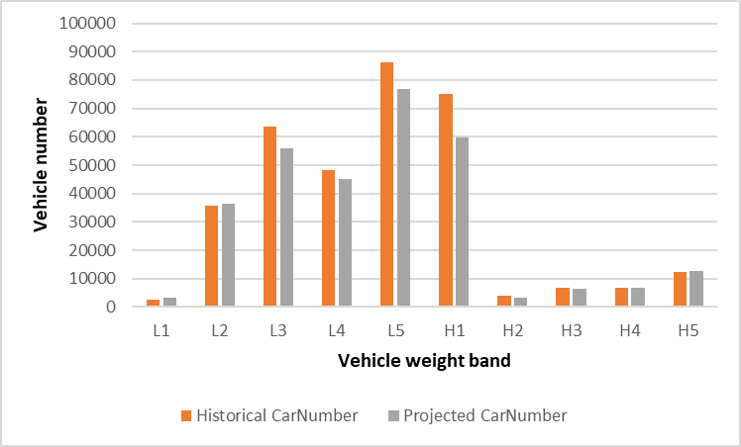
The number of goods vehicles by vehicle weight band and fuel
2. Results (Preliminary) - Projection
Year of 2016
Diesel

Slide 24
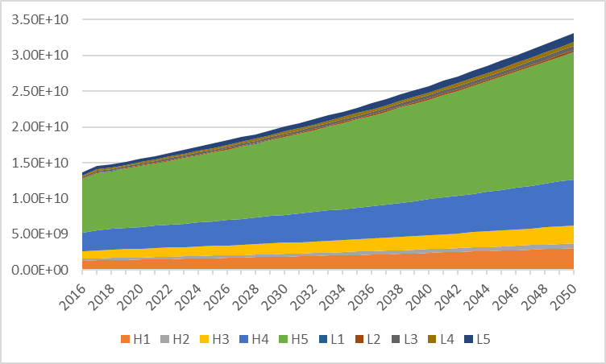
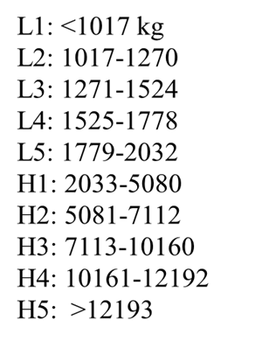
Business As Usual
2. Results (Preliminary) - Projection
Fuel related taxes (carbon tax, fuel taxes and diesel rebate scheme)
Vehicle taxes
Fuel economy/emission standard

Slide 25

Thanks!

