Slide 1


Budget 2026: A Macroeconomic Perspective
Conor O’Toole
10th October 2025

Slide 2
Autumn 2025 QEC – Pre Budget Assessment of Budget 2026
Domestic economy performing robustly despite international uncertainties
Pre-budget recommendations suggested limiting net spending growth
We have previously signalled concerns about the fiscal stance whereby deficits – once account is taken of windfall corporate tax receipts – have been run for the last number of years.
Our concerns were (still are) twofold:
  First, counter-cyclical fiscal policy requires that fiscal policy reduce demand pressures in the economy towards the peak of the economic cycle.
  Second, the windfall nature of a large proportion of Ireland’s corporate tax receipts means that they could vanish quickly.
Will walk through overall budgetary position in Budget 2026 relative to this context

Slide 3
Budget 2026 – Main macroeconomic elements
Overall budgetary package
  €9.4bn across taxation and expenditure
  This is composed of:
    €6.1bn in additional current expenditure
    €2bn in additional capital expenditure
    €1.3bn permanent tax measures
Size of government expenditure
  Total voted spend in 2026 – €117.8bn, non-voted. €15.9bn
Tax measures – €1.3bn
  VAT cuts for hospitality, new building on apartments, extension of VAT rate for electricity and gas @9%
  R&D credits
Spending measures - € 8.1bn
  Broad based - spending measures point towards increasing service delivery – more employees
  Considerable focus on housing and related infrastructure
  More permanent in nature, less one-off measures

Slide 4
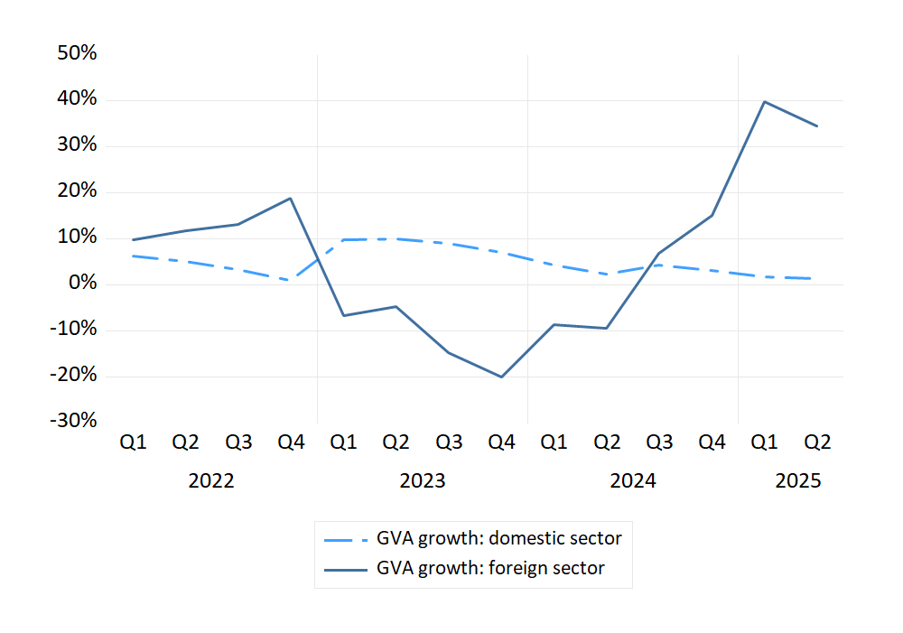
Where is the macroeconomy at present?
GVA growth – year-on-year – domestic vs foreign-dominated sectors (Constant prices, seasonally adjusted)
The economy continues to perform robustly:
  Consumption +3 percent in Q2
  Employment +2.3 percent in Q2
  tax receipts +4.4 percent to end-August.
We expect modified domestic demand to grow by 3.8 percent in 2025 and by 2.9 percent in 2026
While EU/US agreement reduced uncertainty in the short term, the new situation of a 15 percent tariff represents a deterioration in our trading environment.
Uncertainty remains elevated – international risks.
Indicator (Growth, %) | 2024 | 2025 | 2026
Gross Domestic Product (GDP) | 2.5 | 8.0 | 2.0
Modified Domestic Demand (MDD) | 1.7 | 3.8 | 2.9

Slide 5
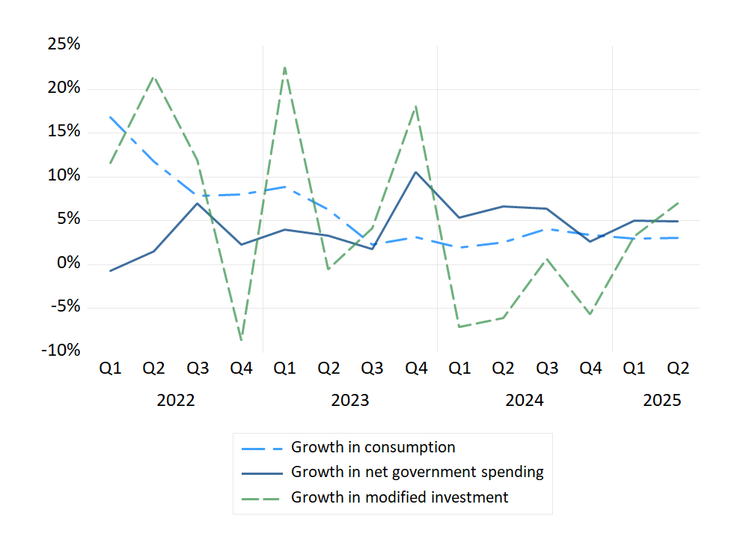
Domestic Economic Developments
Components of Modified Domestic Demand – year-on-year – (Constant prices, seasonally adjusted)
Continued strong consumption expenditure growth
  Rising nominal incomes, moderating inflation, continued high savings ratios
  Potential downside risks from uncertainty
Investment increasing notably in Q2, driven by higher housing and construction (to be discussed)
Net government expenditure also growing rapidly
Indicator | 2024 | 2025 | 2026
Modified Investment | -4.2 | 5.9 | 3.3
Net Government Spending | 7.1 | 4.5 | 3.5
Consumption | 3.0 | 2.9 | 2.5

Slide 6
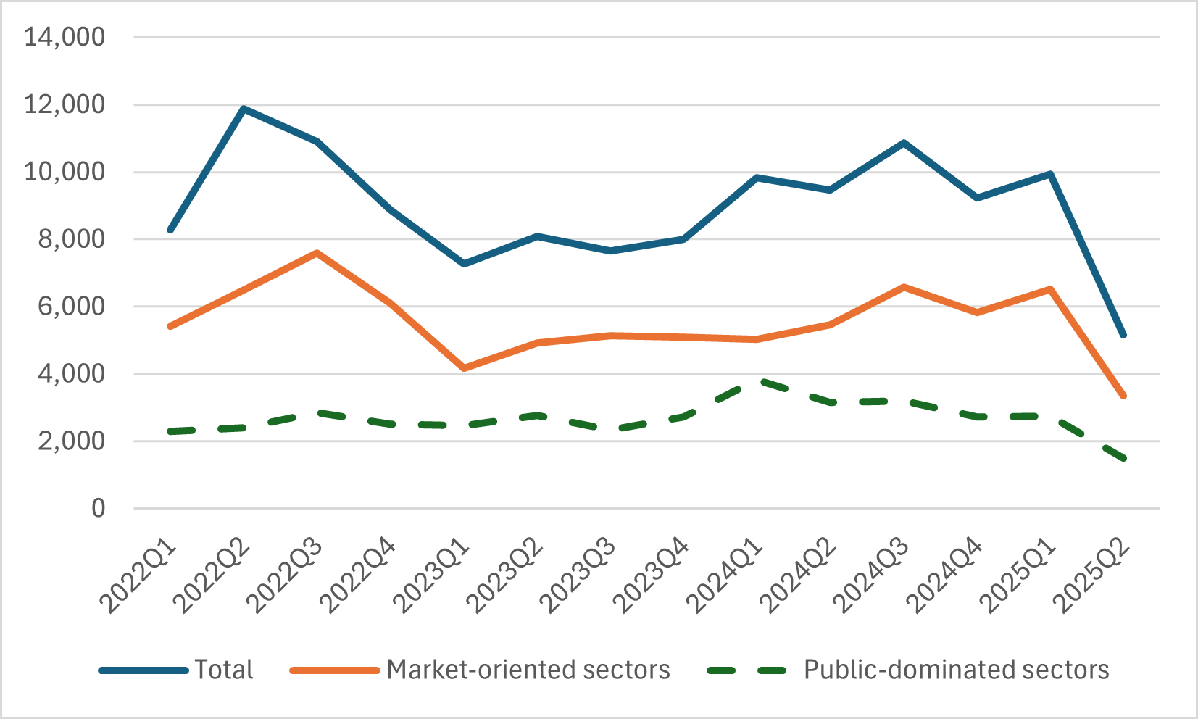
Labour Market
Number of Work Permits Issued by Sector – Market-oriented vs Public Sector
Labour market continues to operate at capacity
  low unemployment rate over forecast horizon
Employment growth has been strong in recent years, despite degree of uncertainty and repeated international shocks
Some tentative signs of softening in labour market – lower work permits in market-oriented sectors and lower vacancy rate if public sector is excluded
Indicator (%) | 2024 | 2025 | 2026
Unemployment Rate (%) | 4.3 | 4.6 | 4.6
Employment Growth (%) | 2.7 | 2.0 | 1.6

Slide 7
Government expenditure growing rapidly
Gross Voted Government Expenditure (€mn, nominal) – Current and Capital Expenditure
Growth Rate in Nominal Gross Voted Expenditure – Capital and Current (Year-on-Year)

Slide 8
Compensating for inflation and a growing population?
Per Capita Real Spending Trends (€ per person, CPI adjusted)

Slide 9
Where is the expenditure going?
Gross Voted Government Expenditure (€mn, nominal) – By Vote Group – Current Spending
Gross Voted Government Expenditure (€mn, nominal) – By Vote Group – Capital Spending

Slide 10
Expenditure patterns – hold back firepower for downturns…
Gross Voted Government Expenditure & Modified Final Domestic Demand – Nominal Growth Rates

Slide 11
Underlying structural challenges – windfall reliance
General Government Balance, Corporation Tax Windfalls
Corporation Tax, Windfalls as % of Total Tax Revenue

Slide 12
Overall macroeconomic assessment
Budget 2026 comes at a time of robust economic activity domestically but increasing international uncertainties
Economy expected to perform well across forecast horizon but some tentative signs of moderation in labour market and non-construction investment
Government expenditure has increased notably in recent years
  Economy doesn’t need additional support at present
    Additional taxation and spending measures present overheating risk
    Additional spending on new employment for service delivery could be challenging in capacity constrained economy
    Lack of major changes to (personal) taxation important and welcome to strengthen resilience
  Need to break the pro-cyclicality of spending in long run, in particular maintain capital expenditure
  Windfall element of corporation tax to account for over 17 per cent of all tax revenue in 2026
    Risks to stability and resilience of public finances if these were to evaporate/dissipate
    Potential correlated risk between component of income tax for FDI workers and corporation tax from FDI sector

Slide 13
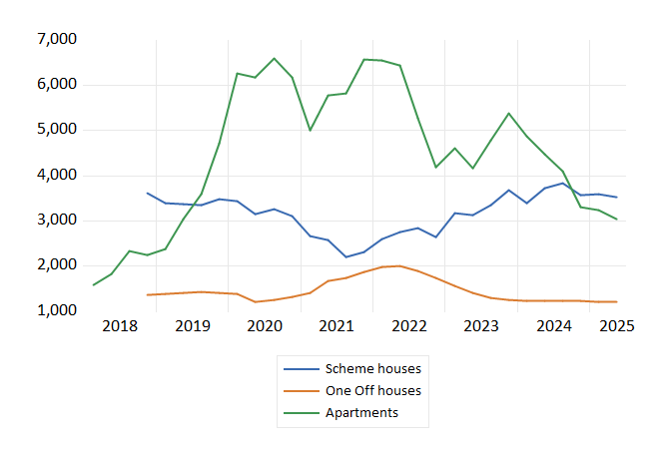
Capital investment, bottlenecks and housing activity
Budget 2026 contains a range of measures aimed at targeting housing activity & infrastructure
Record increase in capital expenditure for housing
Number of taxation measures (VAT reduction on new build apartments, corp tax changes ) aimed at addressing apartment “viability gap”
Zero corp tax on cost rental
More structural taxation measures for land activation
  Residential zoned land tax continues
  Derelict sites tax
Major challenge with addressing infrastructure
  Additional funding for Irish Water - +€500mn approx.
  Equity investment in Irish water to 2030 for major projects – Water Supply and Dublin Drainage
Trend in Planning Permissions – Moving Average 4 Quarter – (% Change)

Slide 14
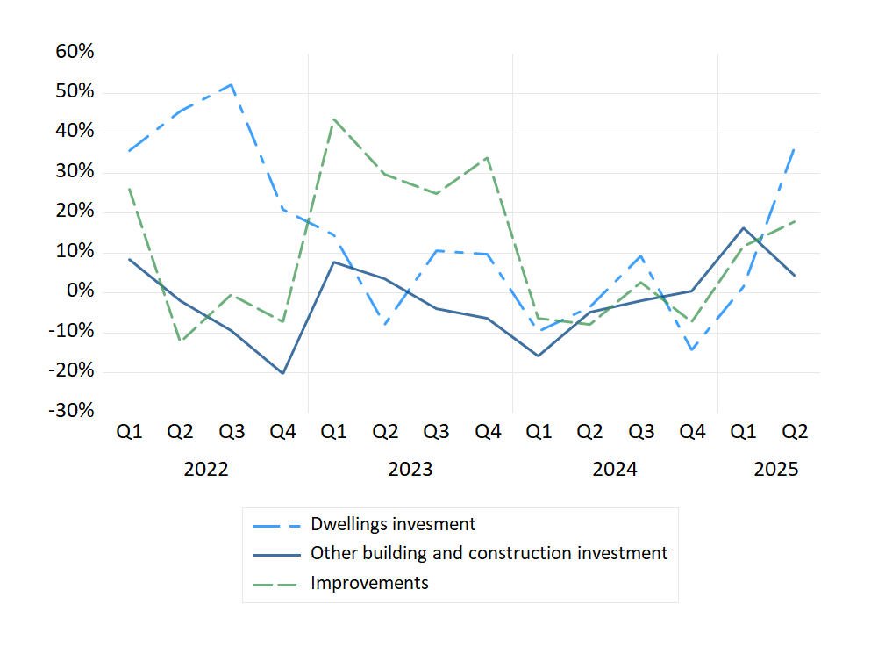
Capital investment – Much to do, finite capacity
Components of Construction Investment – year-on-year – (Constant prices, seasonally adjusted)
Construction sector capacity
Broader infrastructure (water, electricity, transport etc)
Retrofitting and renovations
Residential construction
Commercial property etc

Slide 15
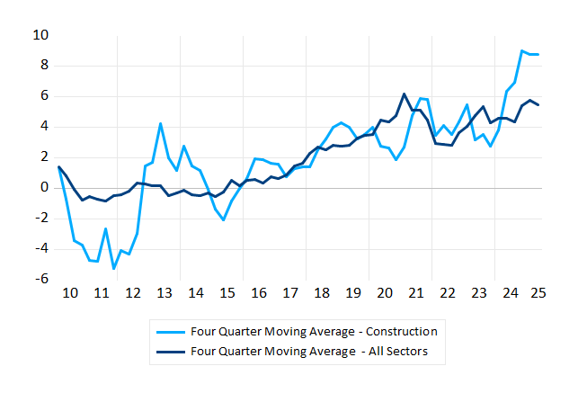
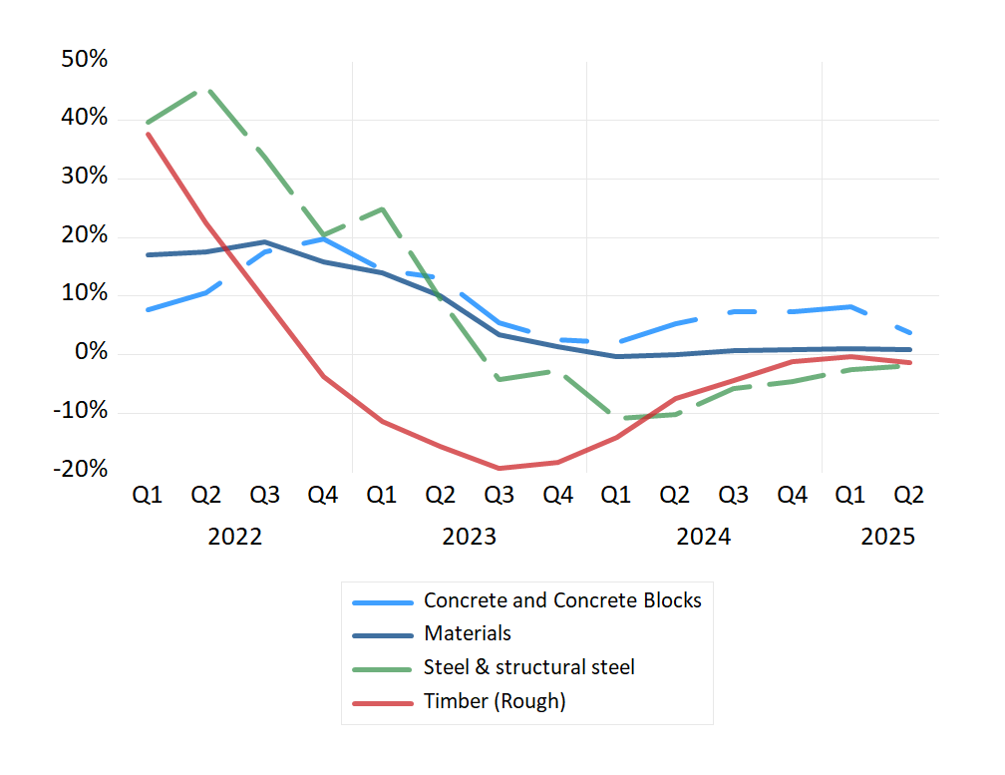
Housing Output – Cost Inflation
Materials Costs for Construction – year-on-year – (% Change)
Trend in Construction Wages – Moving Average 4 Quarter – (% Change)

Slide 16
Assessment: infrastructure and housing
Major capacity constraints in housing and infrastructure, threatening competitiveness and societal impacts on households
Additional funding is coming online for housing and infrastructure
  Additional funding for social homes
  Infrastructure spending through Irish Water
Structural changes needed to achieve aims in long run
  Increased productivity in construction sector
  Additional employees required to increase output
  Capital investment deficit in machinery and equipment and small firm sizes (CBI).
  Reforms to planning system to reduce uncertainty and timelines
  Supporting infrastructure must unlock housing
Must prioritise between housing, retrofits, infrastructure and non-residential

Slide 17





Thank you
ESRI.ie
Economic and Social Research Institute (ESRI)
Economic and Social Research Institute (ESRI)
@ESRIDublin
Sign up to our Newsletter

